Slide 1

Malignant comments classification
Submitted by:
Ankita Ramdas Mhetre

Slide 2

Conceptual Background and domain knowledge
Due to the penetration of the internet in all domains of life there is an increase in people’s participation in all activities.
People actively give remarks as an issue of communicating their concern/feedback/opinion in various online forums.

Slide 3
Conceptual Background and domain knowledge
Although most of the times these comments are helpful for the creator to extemporize the substance that is being provided to people, but sometimes these may be abusive and create hatred-feeling among the people.
As these are openly available to the public which is being viewed from various sections of the society, people in different age groups, different communities and different socio-economic background.
It becomes the prime responsibility of the content-creator ( the host) to filter out these comments in order to stop the spread of negativity or hatred within people.

Slide 4
Why do we need comment classification
To protect users from being exposed to offensive language on online forums or social media sites.
Unfortunately, many online discussions devolve into acrimonious arguments, or outright harassment.
If conversations are so bad that people leave the discussion, then we have clearly failed to have an online discussion, let alone a good one! This was the basis for working on this project
Few companies have started flagging comments and blocking users who are found guilty of using unpleasant language.
Several Machine Learning models can be developed and deployed to filter out the unruly language and protect internet users from becoming victims of online harassment and cyber bullying.

Slide 5
Problem Definition
There has been a remarkable increase in the cases of cyber bullying and trolls on various social media platforms. Many celebrities and influences are facing backlashes from people and have to come across hateful and offensive comments.
This can take a toll on anyone and affect them mentally leading to depression, mental illness, self-hatred and suicidal thoughts.
Our goal is to build a prototype of online hate and abuse comment classifier which can used to classify hate and offensive comments so that it can be controlled and restricted from spreading hatred and cyber bullying.
We need to build a prototype of online hate and abuse comment classifier which can used to classify hate and offensive comments so that it can be controlled and restricted from spreading hatred and cyber bullying.

Slide 6
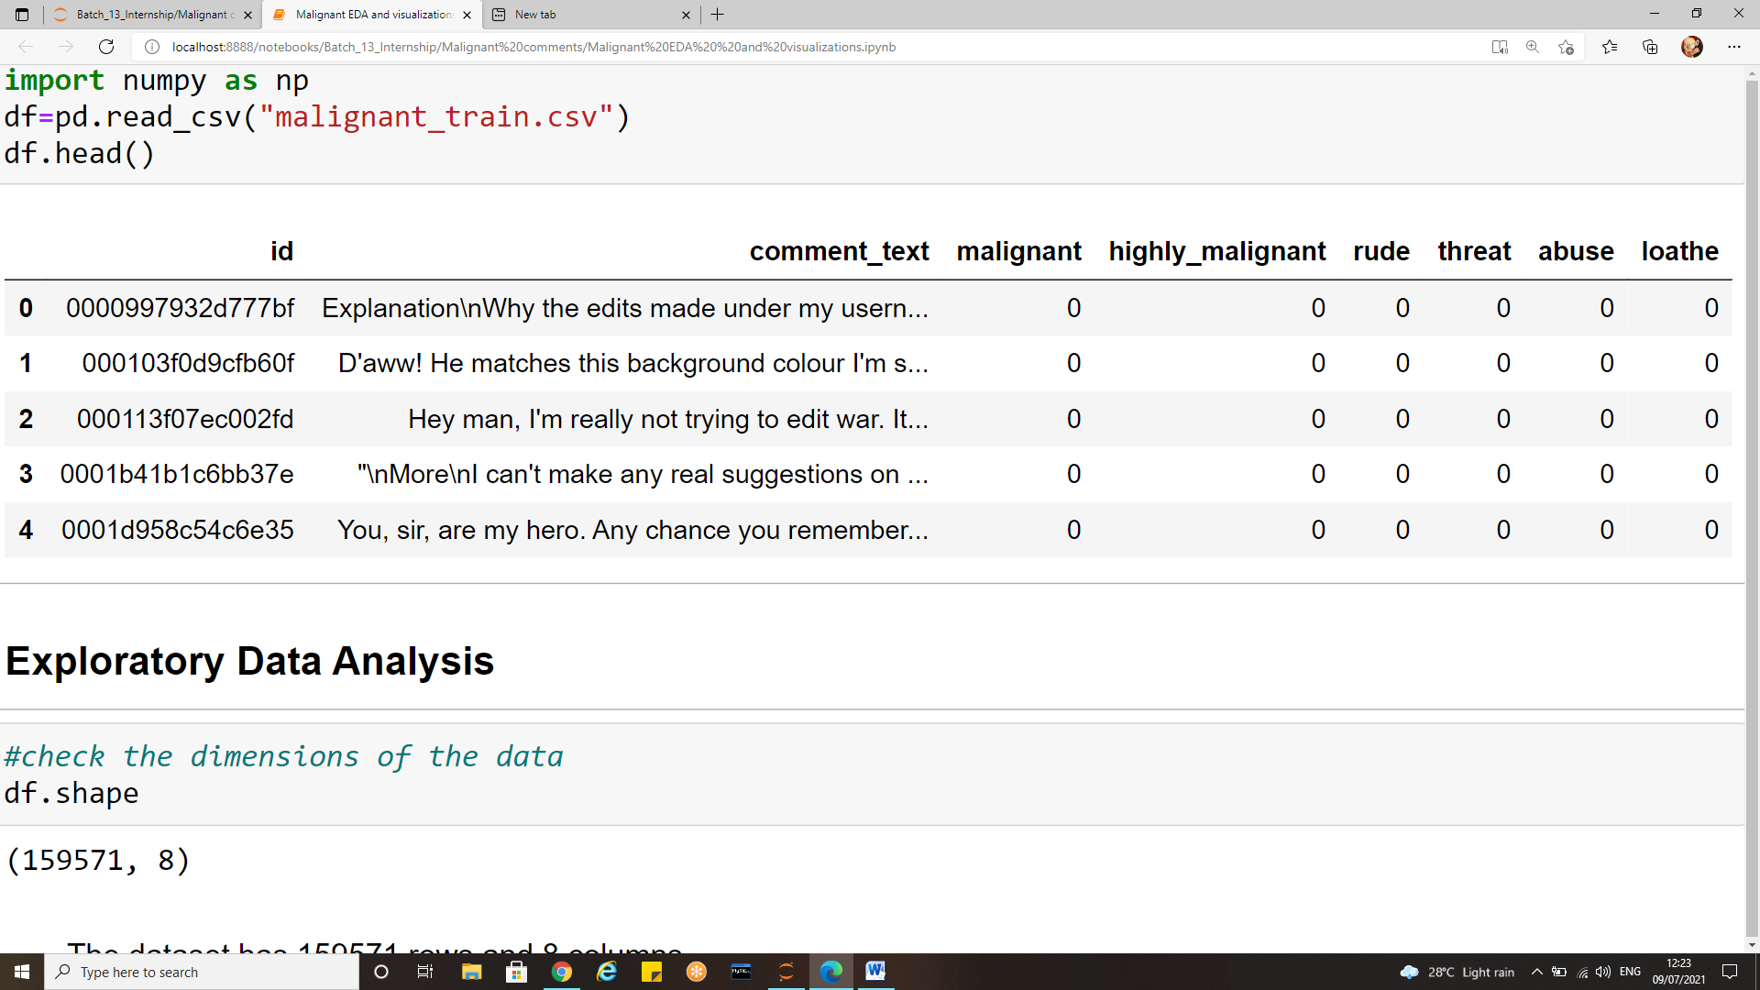
Dataset Description
The data set contains the training set, which has approximately 1,59,000 samples and the test set which contains nearly 1,53,000 samples. All the data samples contain 8 fields which includes ‘Id’, ‘Comments’, ‘Malignant’, ‘Highly malignant’, ‘Rude’, ‘Threat’, ‘Abuse’ and ‘Loathe’.
The label can be either 0 or 1, where 0 denotes a NO while 1 denotes a YES. There are various comments which have multiple labels. The first attribute is a unique ID associated with each comment.
Fig: Sample instance of dataset

Slide 7
Dataset Description
The data set includes following columns:
Malignant: It is the Label column, which includes values 0 and 1, denoting if the comment is malignant or not.
Highly Malignant: It denotes comments that are highly malignant and hurtful.
Rude: It denotes comments that are very rude and offensive.
Threat: It contains indication of the comments that are giving any threat to someone.
Abuse: It is for comments that are abusive in nature.
Loathe: It describes the comments which are hateful and loathing in nature.
ID: It includes unique Ids associated with each comment text given.
Comment text: This column contains the comments extracted from various social media platforms.

Slide 8
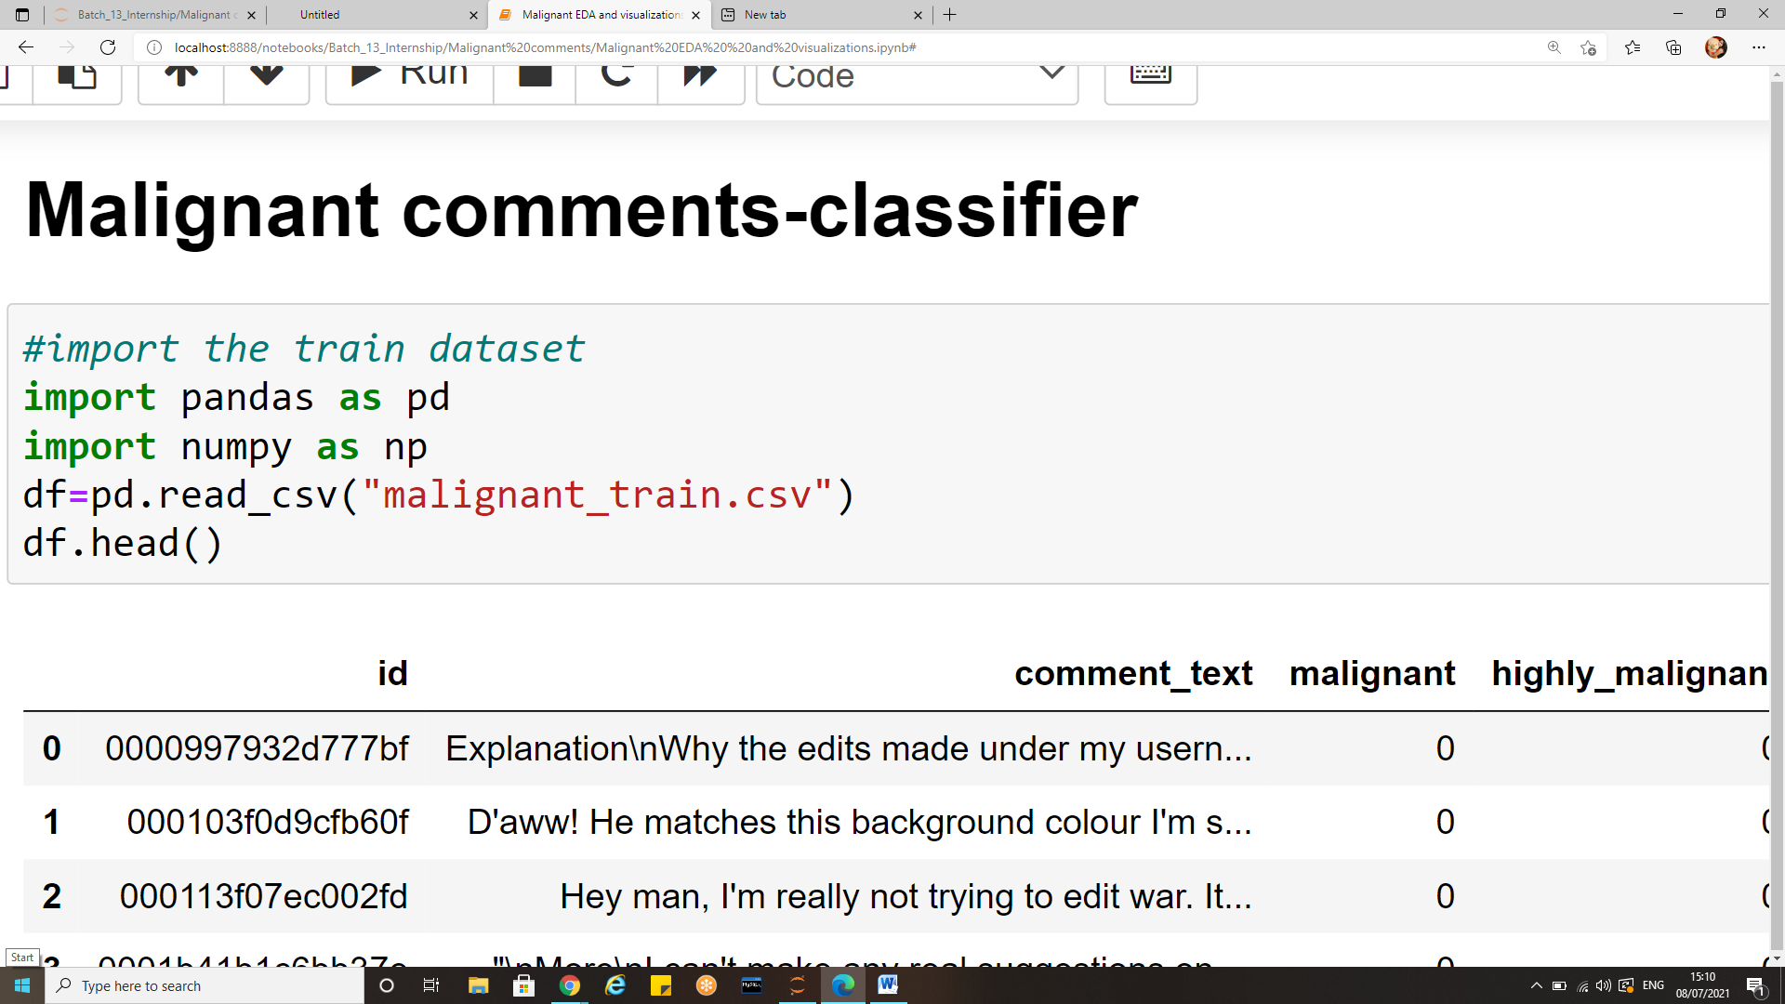
Exploratory Data Analysis (EDA)
Exploratory Data Analysis is one of the important steps in the data analysis process.
Here, the focus is on making sense of the data in hand — things like formulating the correct questions to ask to your dataset, how to manipulate the data sources to get the required answers, and others.
To explore and find inferences from the data first we shall import the dataset as below.

Slide 9
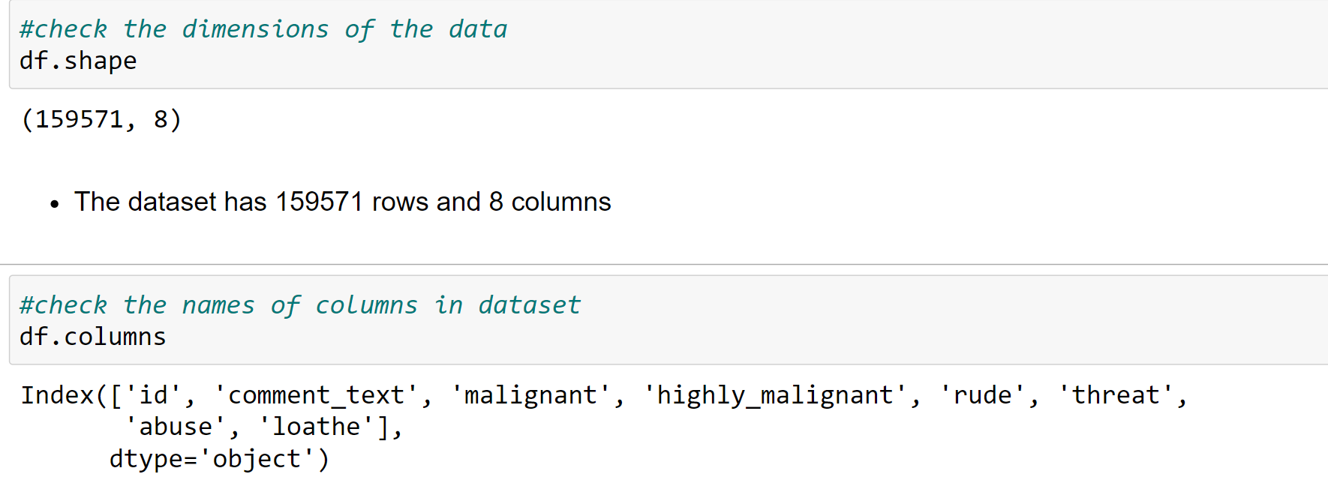
Exploratory Data analysis
Checking the dimensions of dataset. And the features in it. The train data has a total of 159571 records and 8 columns. The column names are shown in the below snapshot.

Slide 10
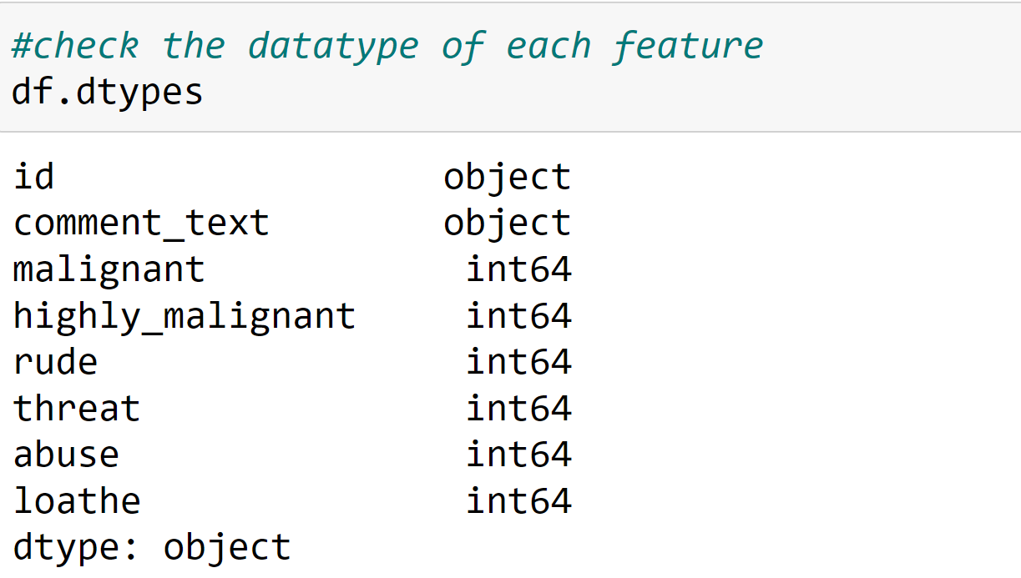
Exploratory Data analysis (EDA)
Checking the data type of each column in the dataset.
There are two columns with "object" data type they are "id" and "comment text“.
"Malignant" , " Highly malignant" , "rude" , "threat" , "abuse" , "loathe" are all integer data type

Slide 11
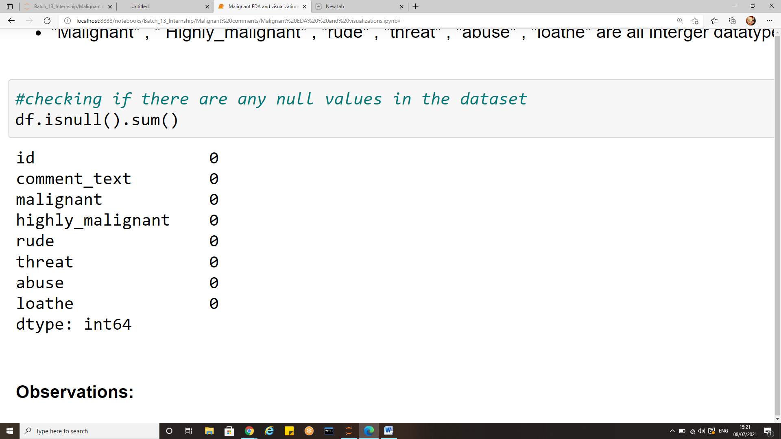
Exploratory Data analysis (EDA)
Checking for null values in the dataset.
There are no null values in the data hence there is no need of imputers in this projects. We can also check for null values using the following command ;
Df.isnull().any() which will yield us a Boolean output

Slide 12
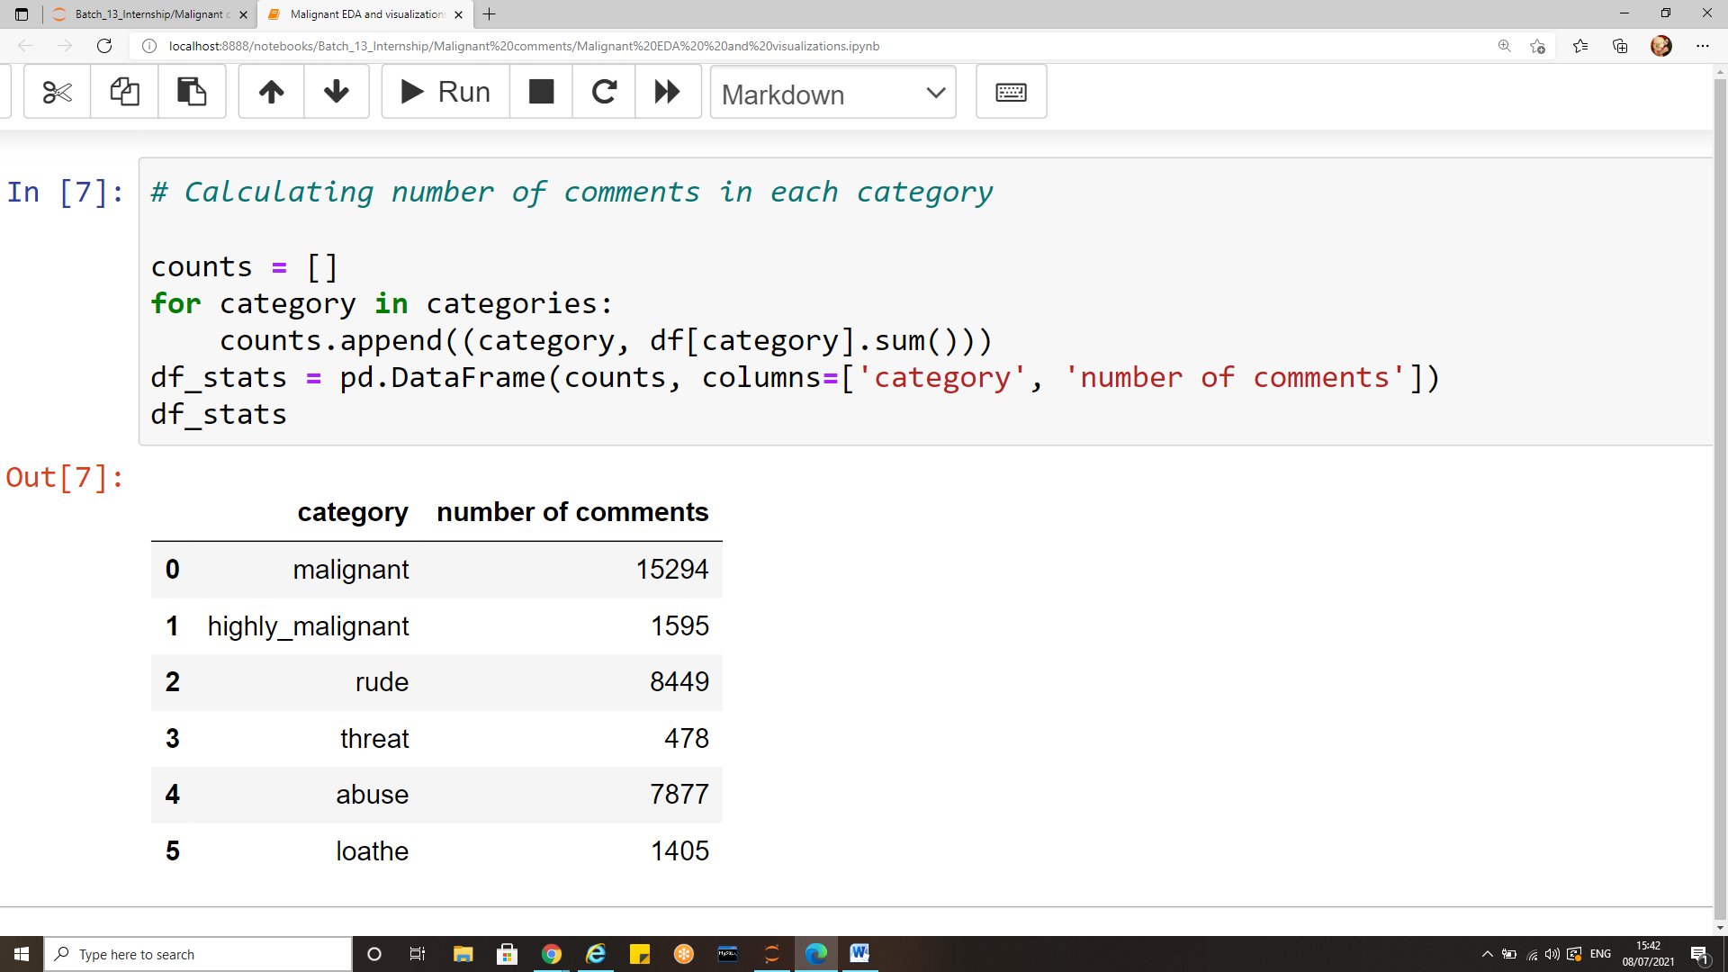
Exploratory Data analysis (EDA)
Number of comments per category:
We dealt with the number of comments belonging to various categories. Malignant comments were highest in number, followed by rude, abuse, highly malignant loathe and abuse in decreasing order.

Slide 13
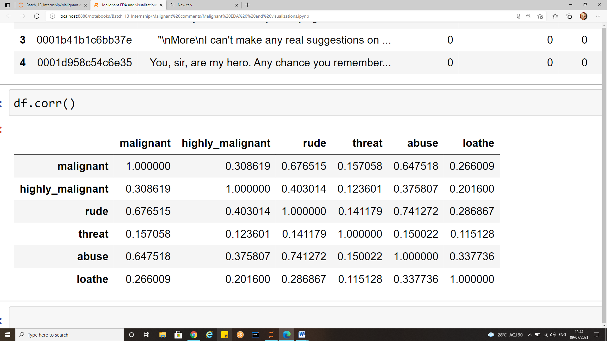
Exploratory Data analysis (EDA)
corr() is used to find the pairwise correlation of all columns in the data frame. Any na values are automatically excluded. For any non-numeric data type columns in the data frame it is ignored. The correlation of a variable with itself is 1.
Maximum correlation can be seen between rude and abuse which has a correlation co-efficient of 0.74.
The second highest correlated variables are rude and malignant with correlation co-efficient of 0.67 and abuse and malignant with correlation coefficient of 0.64.
Threat and loathe have comparatively very less correlation with other labels.

Slide 14
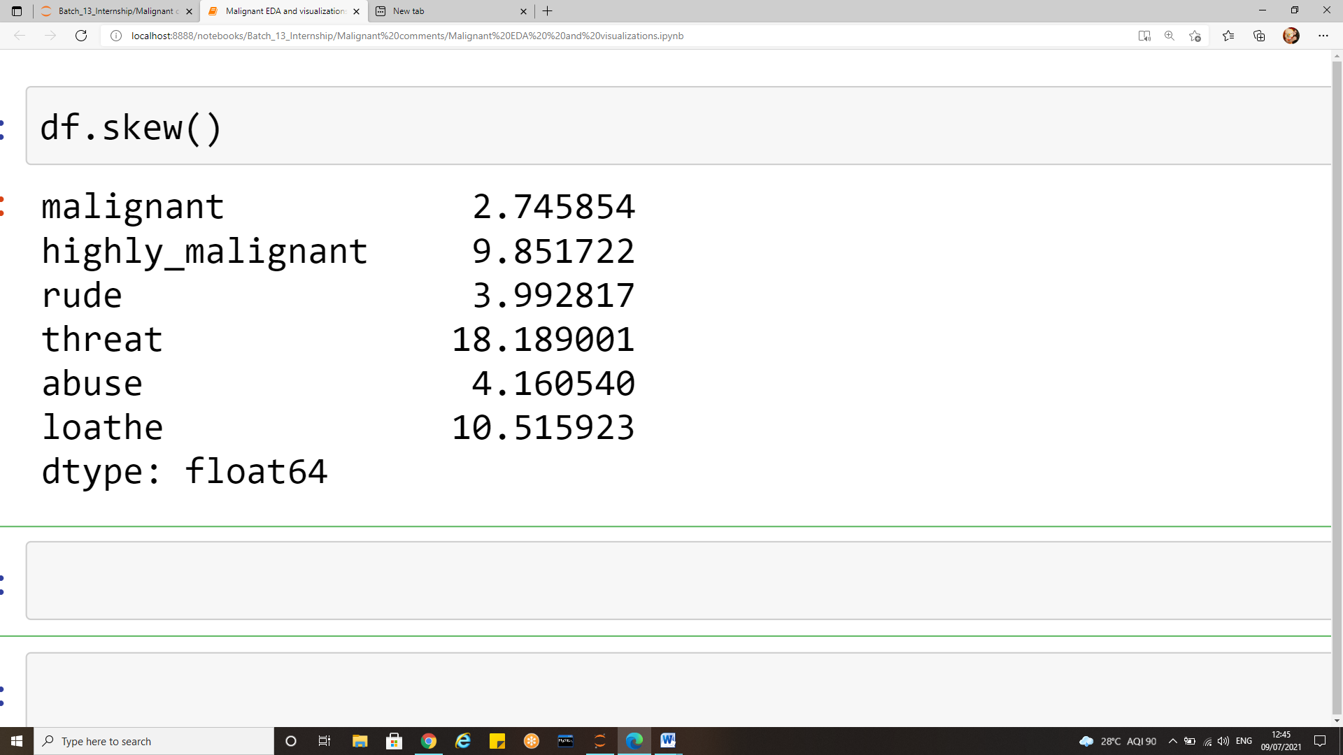
Exploratory Data analysis (EDA)
The distribution of variables is checked using df.skew() function. But as the skewness is in label we are not supposed to treat them, this is just to get an overview of how variables are working

Slide 15
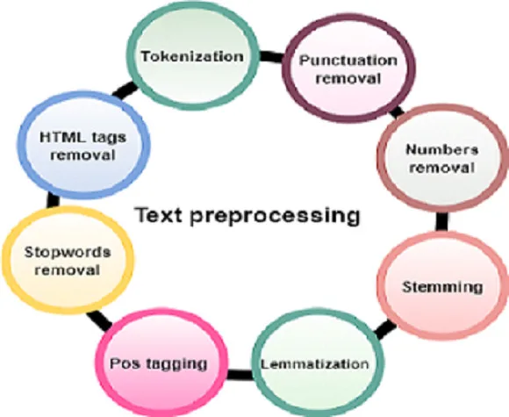
Data Pre-Processing
Natural Language Processing (NLP) is a branch of Data Science which deals with Text data. To prepare the text data for the model building we perform text preprocessing. It transforms text from its raw format into something that is more process able for computer algorithms.
The goal of our pre-processing is to achieve normalization and noise removal from the dataset before we experiment with different embedding and models.

Slide 16
Data Pre-Processing
There are different ways to preprocess text. Here are some of the approaches that we have implemented.
Remove HTML tags
Lowercase all texts
Remove punctuations
Remove stop words
Stemming
TF-IDF

Slide 17
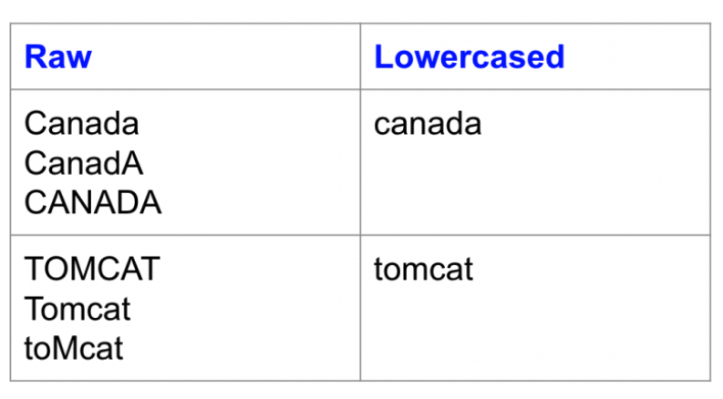
Converting text into lowercase
We first set out to normalize the dataset by converting all the characters to lowercase. This helps us even the playing field for words since lexically a capitalized word should not have a different weight than a non-capitalized word.
Lowercasing is a great way to deal with sparsity issues

Slide 18
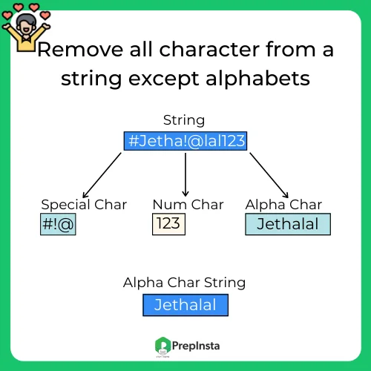
Removing punctuations and special characters
The generic problem faced by the programmers is removing a character from the entire string. But sometimes the requirement is way above and demands the removal of more than 1 character, but a list of such malicious characters.
These can be in the form of special characters for reconstructing valid passwords or some hash tags that are used in comments, any mentions that are indicated by the @ symbol and many other applications possible.

Slide 19
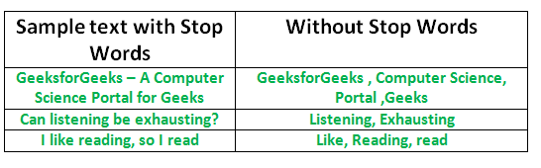
Removing stop words
Common words (like a, an, and, are, as etc.) appear with a high frequency in comments, but add very little value to the classification problem as they do not have any specific polarity. Hence, we decided to remove stop words to further DE noise the input.
We used NLTK’s stop words package to provide us with the list of stop words.

Slide 20
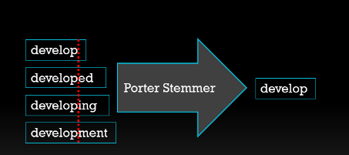
Stemming
Stemming is one of the most common data pre-processing operations we do in almost all Natural Language.
To put simply, stemming is the process of removing a part of a word, or reducing a word to its stem or root. This might not necessarily mean we’re reducing a word to its dictionary root.
We use a few algorithms to decide how to chop a word off. This is, for the most part, how stemming differs from lemmatization, which is reducing a word to its dictionary root, which is more complex and needs a very high degree of knowledge of a language Processing (NLP) projects.

Slide 21
TF-IDF: Term Frequency — Inverse Document Frequency
TF-IDF stands for Term Frequency — Inverse Document Frequency and is a statistic that aims to better define how important a word is for a document, while also taking into account the relation to other documents from the same corpus.
The rationale behind this is the following:
a word that frequently appears in a document has more relevancy for that document, meaning that there is higher probability that the document is about or in relation to that specific word
a word that frequently appears in more documents may prevent us from finding the right document in a collection; the word is relevant either for all documents or for none. Either way, it will not help us filter out a single document or a small subset of documents from the whole set.
So then TF-IDF is a score which is applied to every word in every document in our dataset. And for every word, the TF-IDF value increases with every appearance of the word in a document, but is gradually decreased with every appearance in other documents

Slide 22
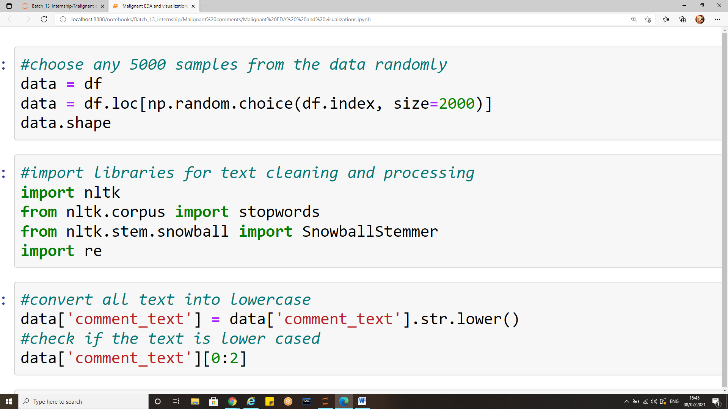
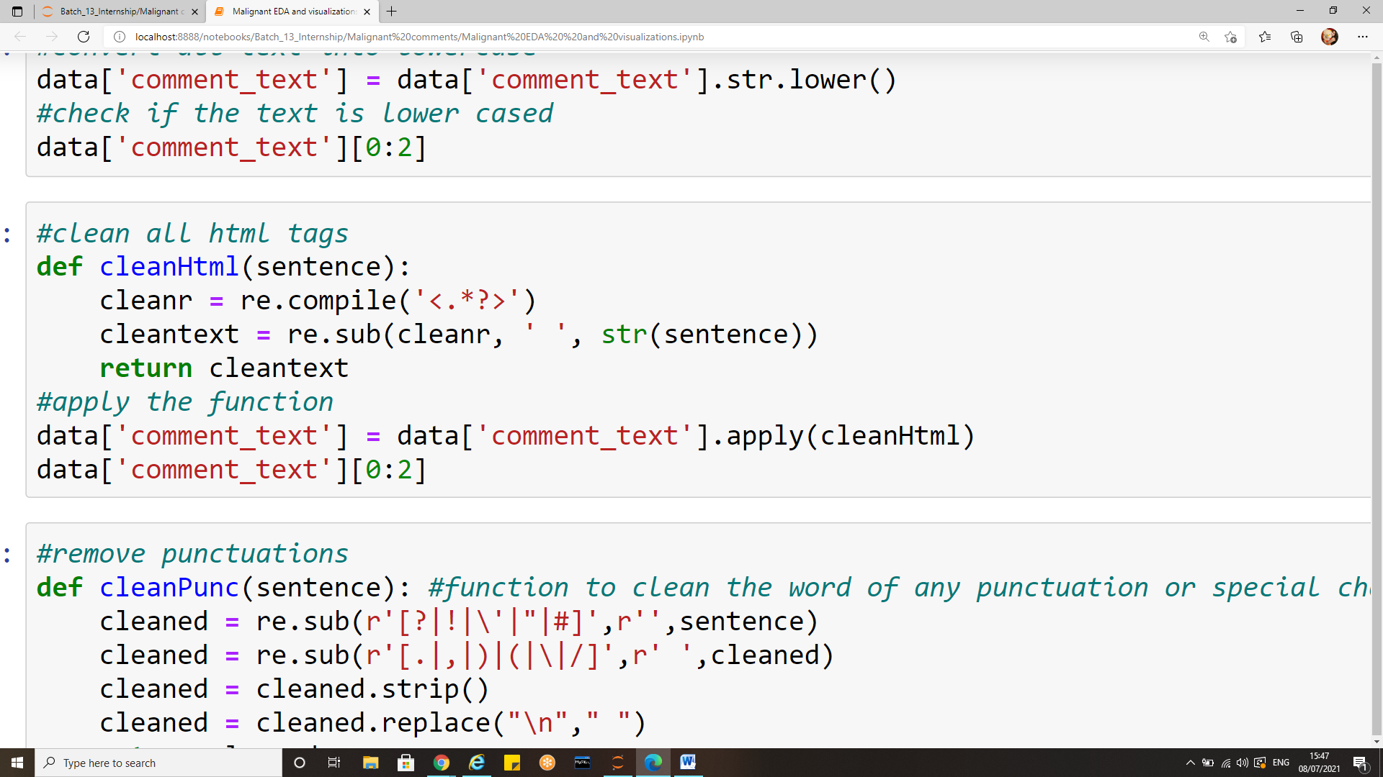
Sample instances of the data pre-processing done
Fig : converting text into lowercase
Fig : removing html tags from the text

Slide 23
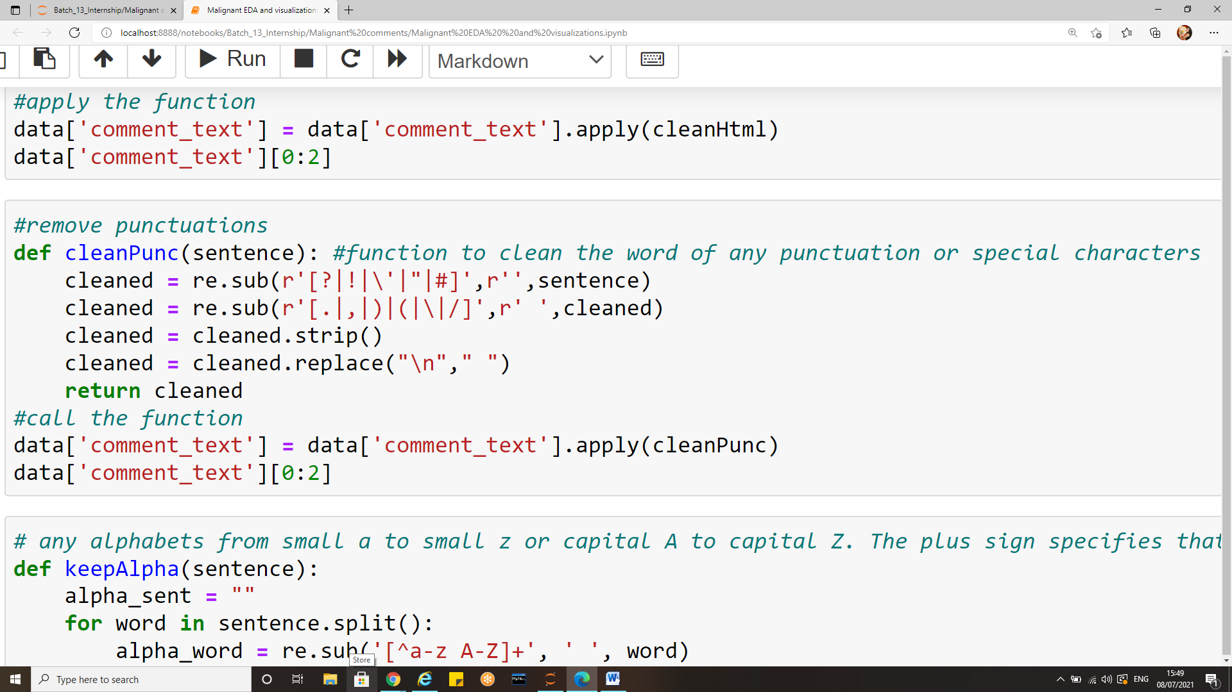
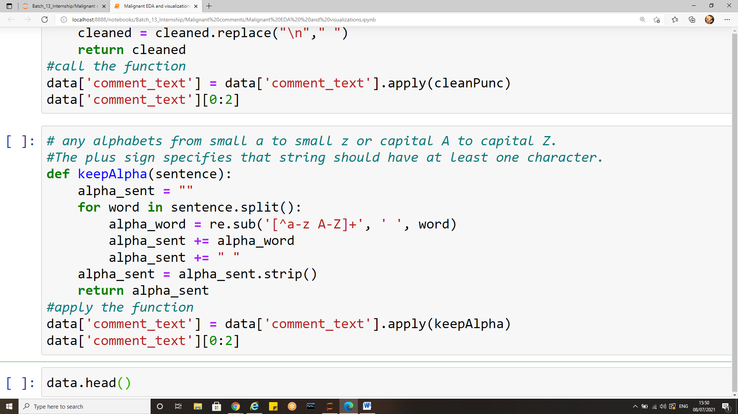
Sample instances of the data pre-processing done
Fig: Removing any punctuations from the text
Fig: keep only numbers and characters

Slide 24
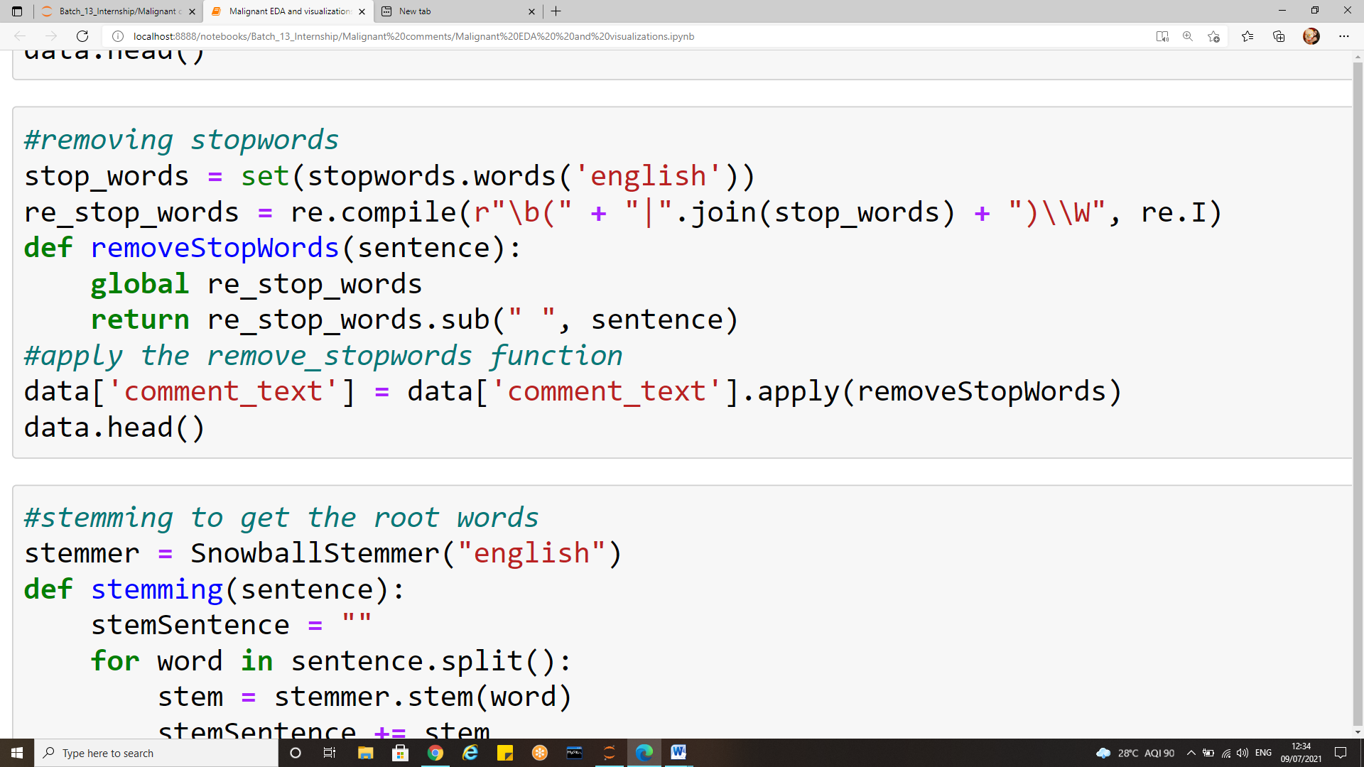
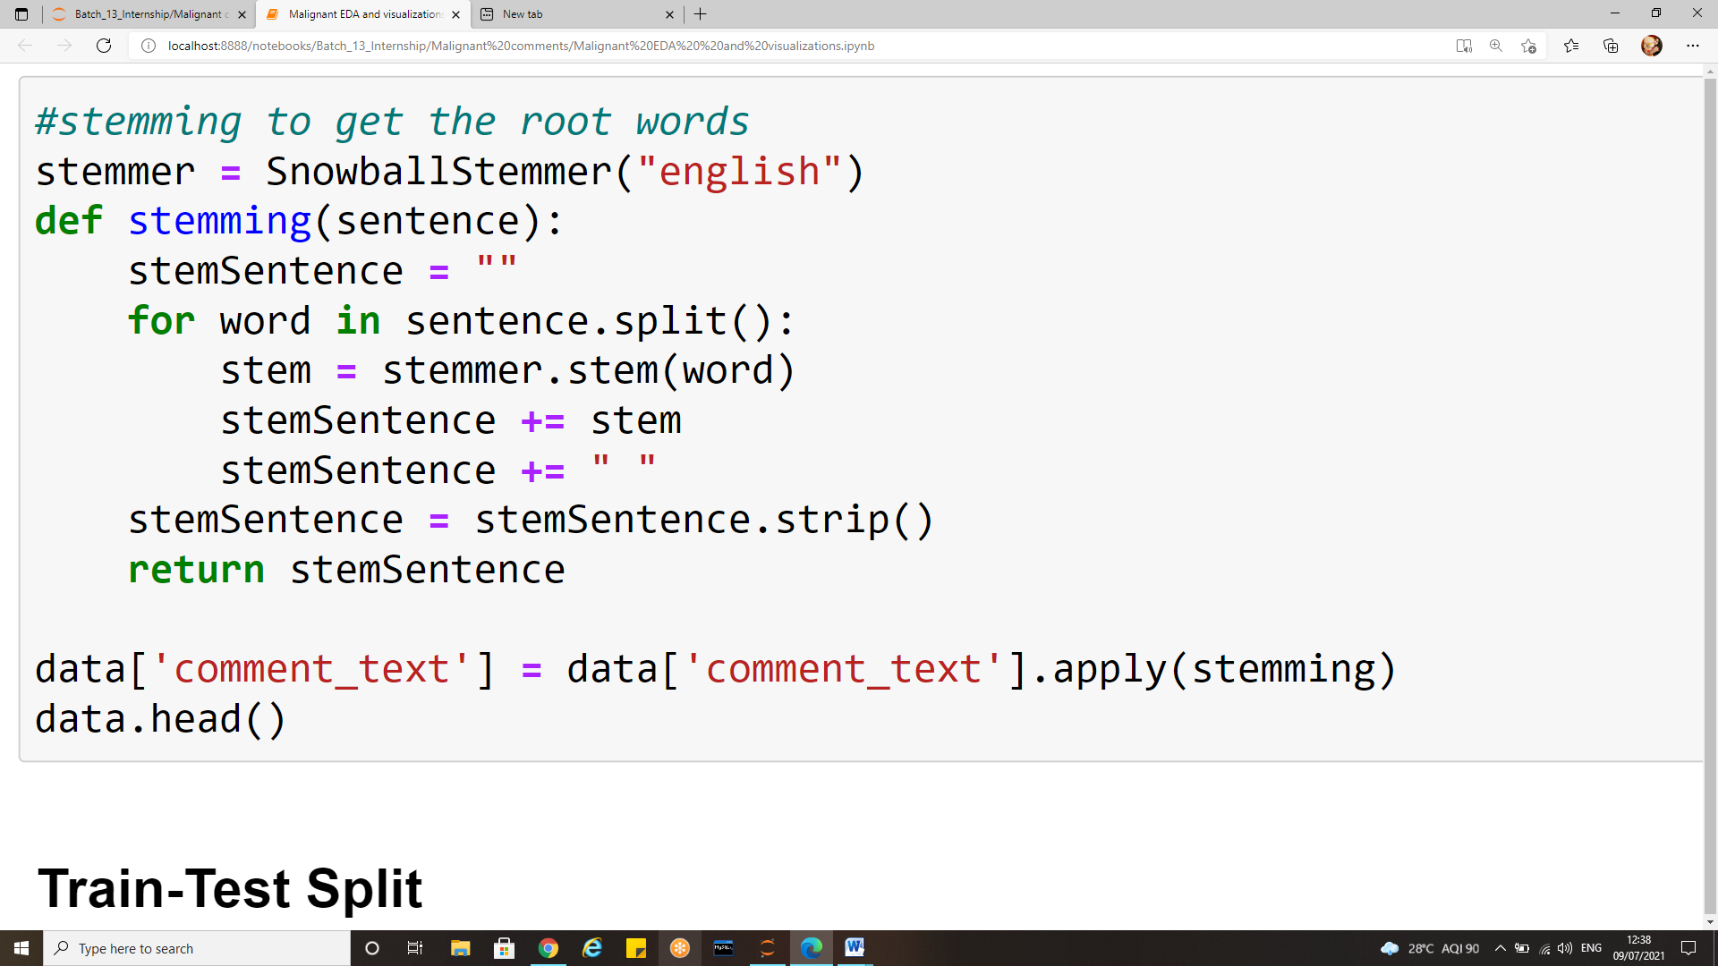
Sample instances of the data pre-processing done
Fig: Removing stop words from the text
Fig: Removing stop words from the text

Slide 25
Data visualization
Data analysis and data visualization are not entirely exclusive work sets – they co-exist and feed off of each other.
Thus data visualization aids in gaining useful insights from large data and makes it easy to understand.
In the journey from analysis to data-driven outcomes, data visualization plays a very important role of presenting data in a powerful and credible way.
There are many different scenarios where large amounts of data must be displayed to an audience – a business may need to present sales figures to their directors.
A research team may need to display their findings to investors, or a teacher may need to display statistics to their students for example.
Data visualization allows this information to be displayed in an easy to read format that is both attractive and functional.

Slide 26
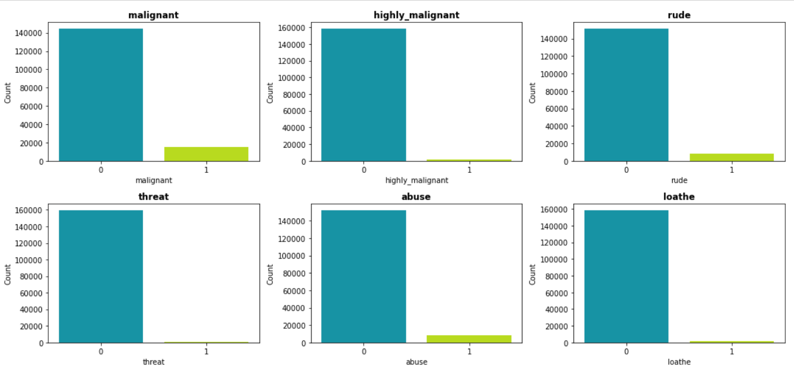
Count plot of each type of comment

Slide 27
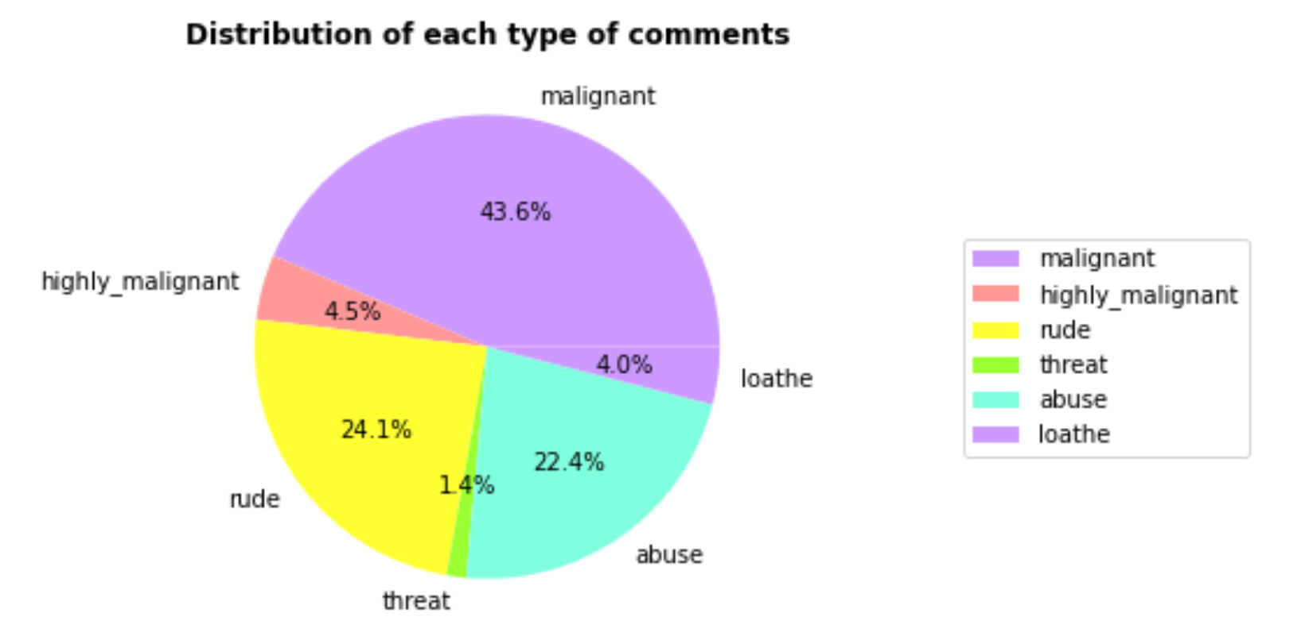
Distribution of type of comments

Slide 28
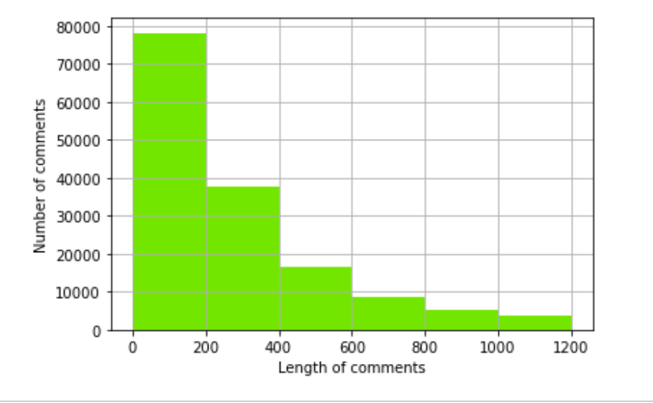
Histogram indicating length of comments

Slide 29
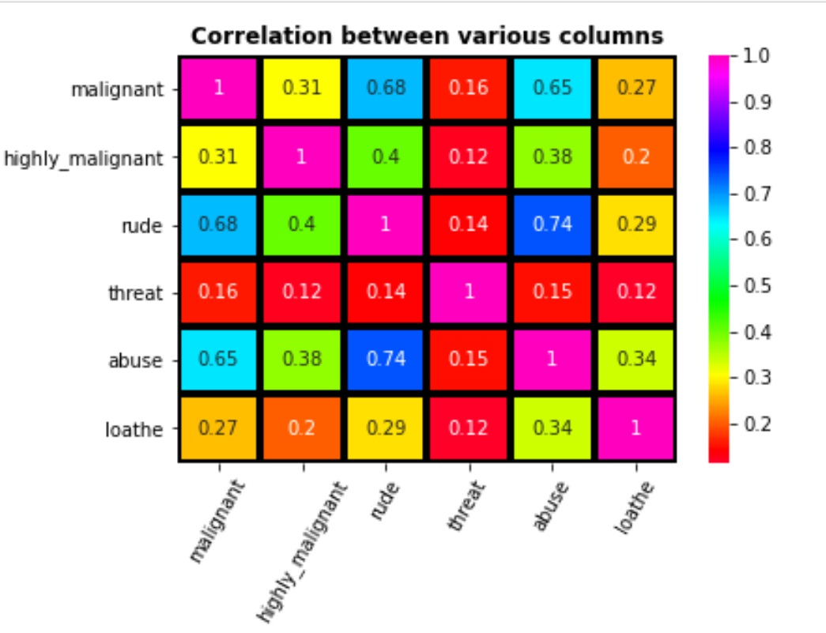
Correlation matrix

Slide 30
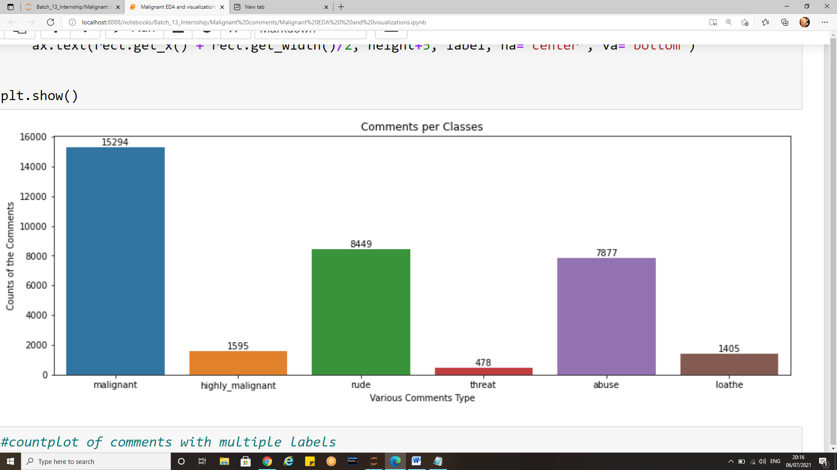
Number of comments in each category

Slide 31
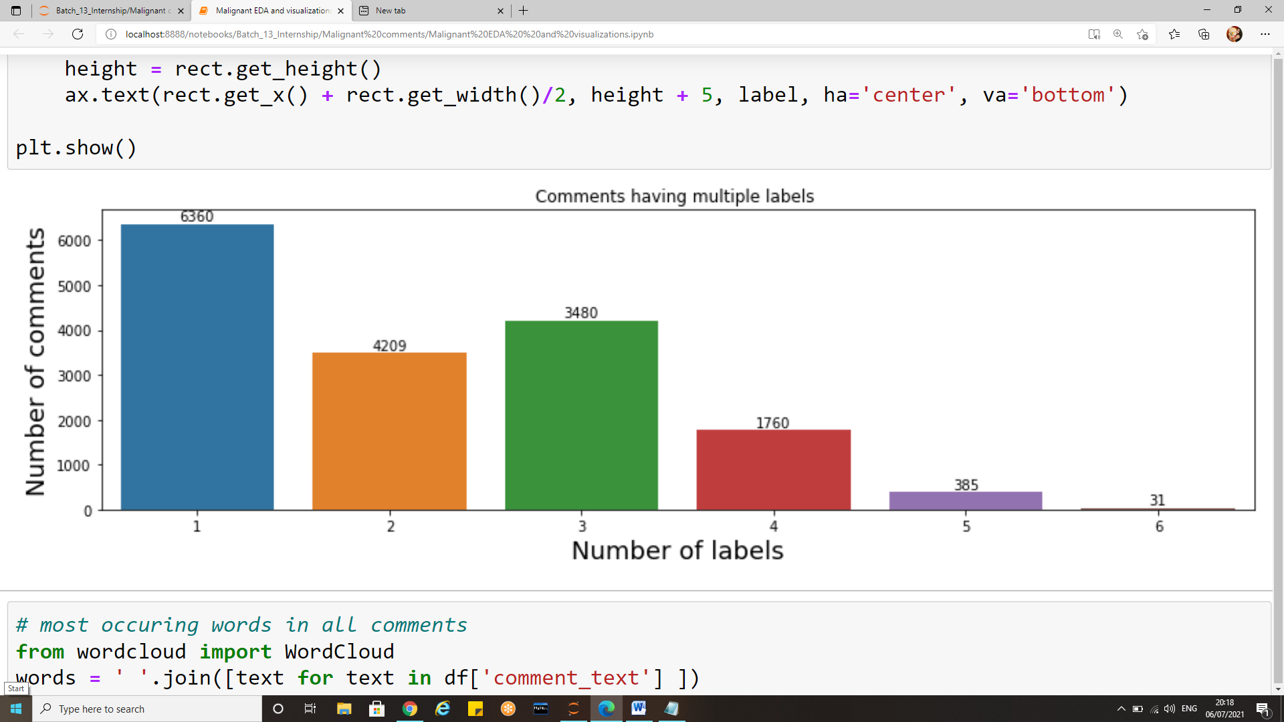
Comments with multiple labels

Slide 32
Word Cloud
Many times you might have seen a cloud filled with lots of words in different sizes, which represent the frequency or the importance of each word. This is called Tag Cloud or WordCloud.
WordCloud is a technique to show which words are the most frequent among the given text. The size of the words represents their frequency. Wordcloud tool is quite handy for exploring text data and making your report livelier.
Each word in this cloud has a variable font size and color tone. Thus, this representation helps to determine words of prominence. A bigger font size of a word portrays its prominence more relative to other words in the cluster.
Word Cloud can be built in varying shapes and sizes based on the creators’ vision. The number of words plays an important role while creating a Word Cloud. More number of words does not always mean a better Word Cloud as it becomes clustery and difficult to read.
A Word Cloud must always be semantically meaningful and must represent what it is meant for.

Slide 33
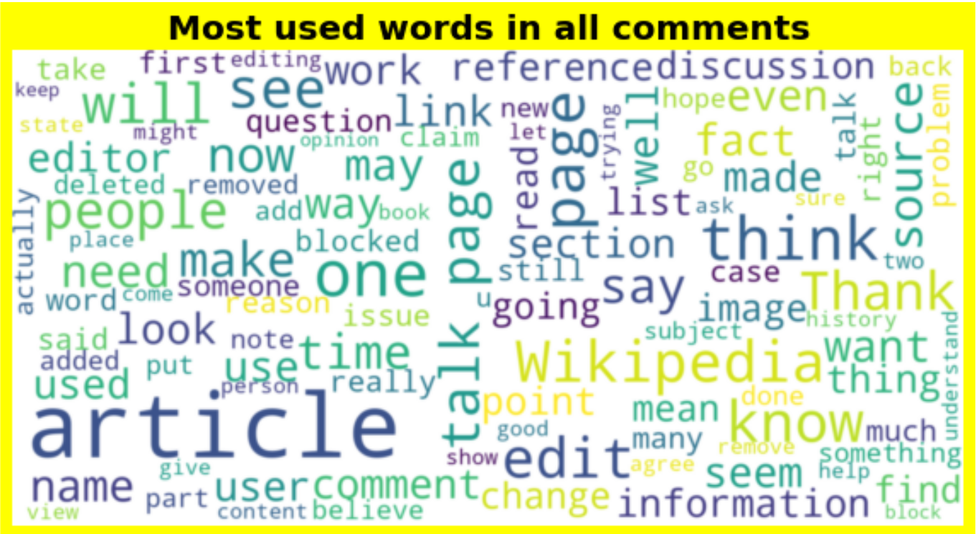
Wordcloud for all comments

Slide 34
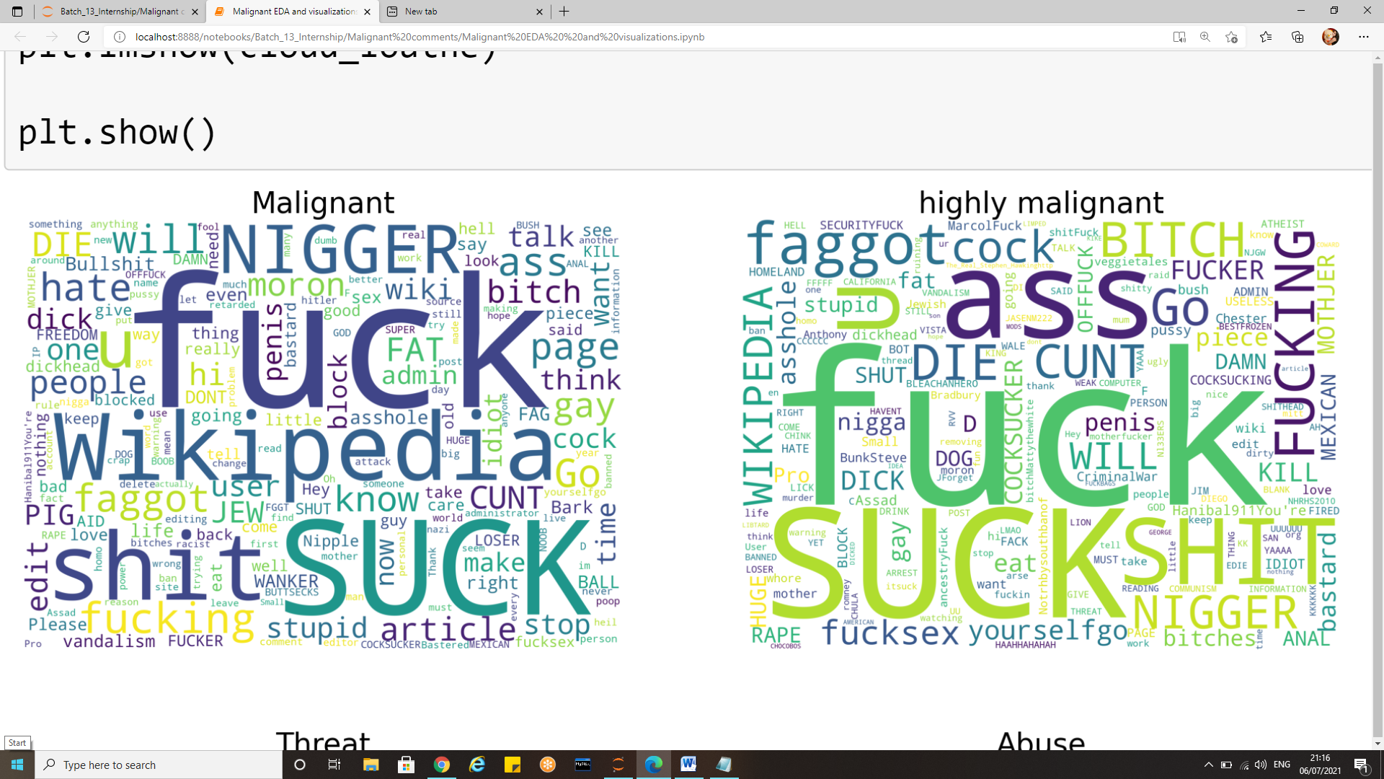
Most used words for malignant and highly malignant comments

Slide 35
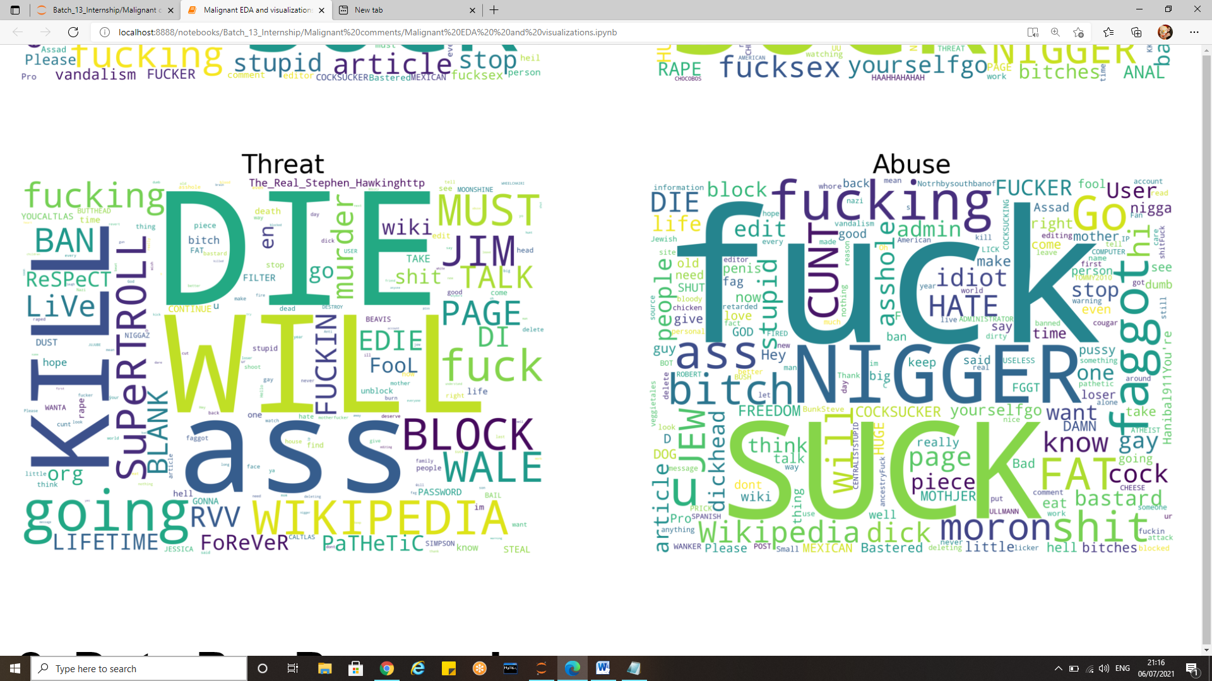
Most used words for threat and abuse comments

Slide 36
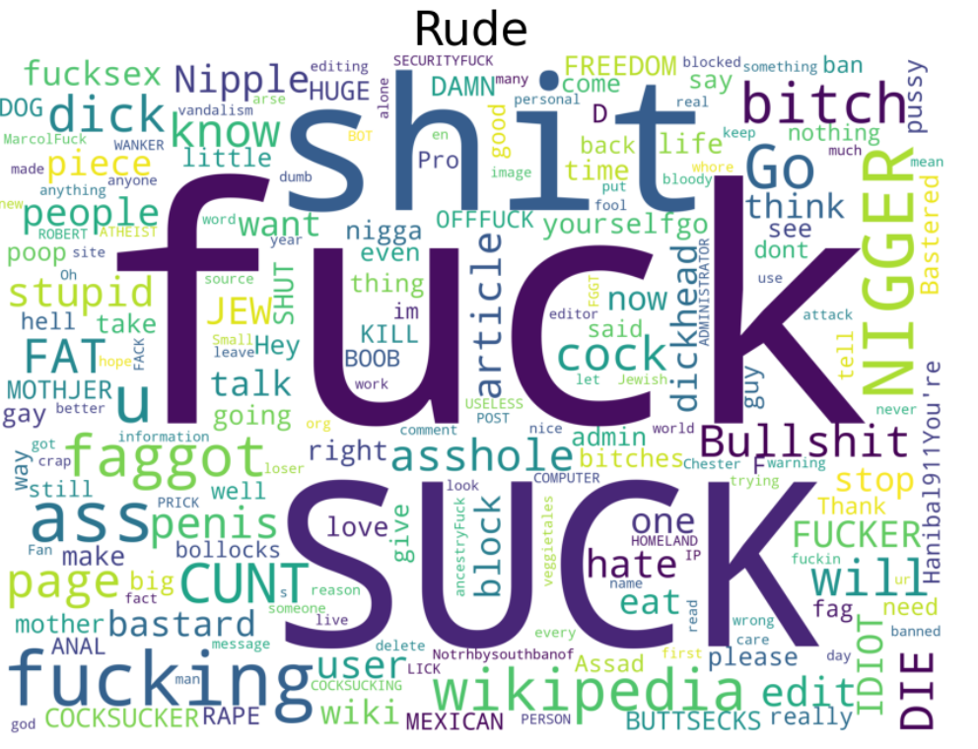
Most used words in rude comments

Slide 37
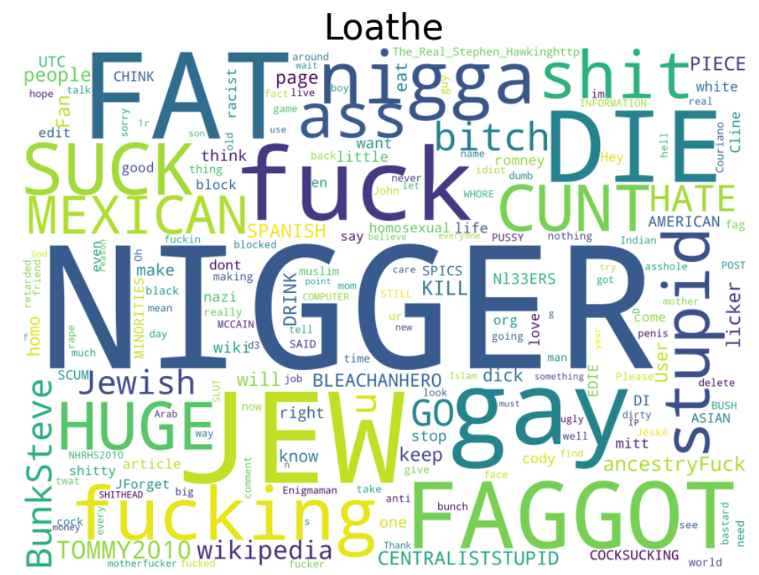
Most used words in loathe type of comments

Slide 38
Approach to solve the problem
As the aim was to find out whether the data belongs to zero, one or more than one from the six in the list, the initial agenda before working on the problem was to audibly differentiate between multi-label and multi-class classification.
In multi-class classification, we undertake one basic assumption that our data can belong to only one label out of all that are available to us.
Whereas, in multi-label classification, data can belong concurrently to more than one label.
The length of the remarks is pretty big so we performed a couple of visualizations in order to make the data more understandable.
We dealt with the number of comments belonging to various categories (which can be perceived from a decisive visualization). Malignant comments were highest in number, followed by rude, abuse, highly malignant loathe and abuse in decreasing order.
There were comments which were both malignant and rude at the same, few were malignant, rude and abuse likewise there were many such combinations for the type of comments.

Slide 39
Approach to solve the problem
The succeeding step was to perform pre-processing of the data. In pre-processing we started off with removal of punctuation and special character from the comments.
We also removed the stop words which are useless as they do not add any value to the dataset i.e. those comments were meaningless.
Further we performed stemming for the words.
Lastly, we applied tfidf vectorizer and afterwards split the information into preparing and testing for the further use.
The next steps involved splitting the data into train and test.The test size used is 0.30 which states 80% of the data is used for training and 20% of the data is used for testing.
After the train test split we have used various multi label classification algorithms to train and test the data.
Respective evaluation metrics are also studied we shall see the details further.

Slide 40
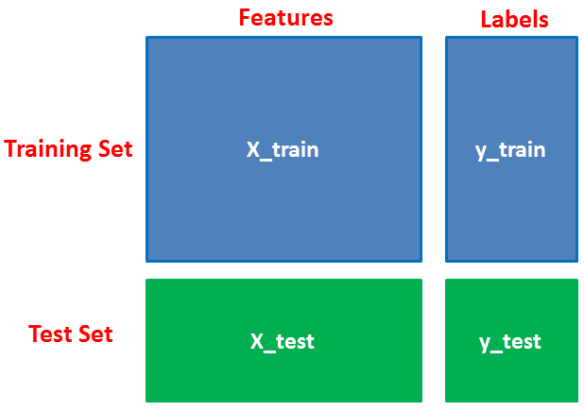
Model Building
The process involves training a model over a set of data, providing it an algorithm that it can use to reason over and learn from those data.
We had to split the dataset into a training set and a test set, and used a test size of 0.2, so that we have values to train our dataset and values to test it with.

Slide 41
Algorithms and evaluation metrics used
Basically, there are three methods to solve a multi-label classification problem, namely:
Problem Transformation
Adapted Algorithm
Ensemble approaches
After the final processing of the data, we applied several supervised learning algorithms including Binary relevance, classifiers chain, label power set and adaptive algorithm.
Their respective performances on the classification of the data were subsequently compared to identify the best algorithm.

Slide 42
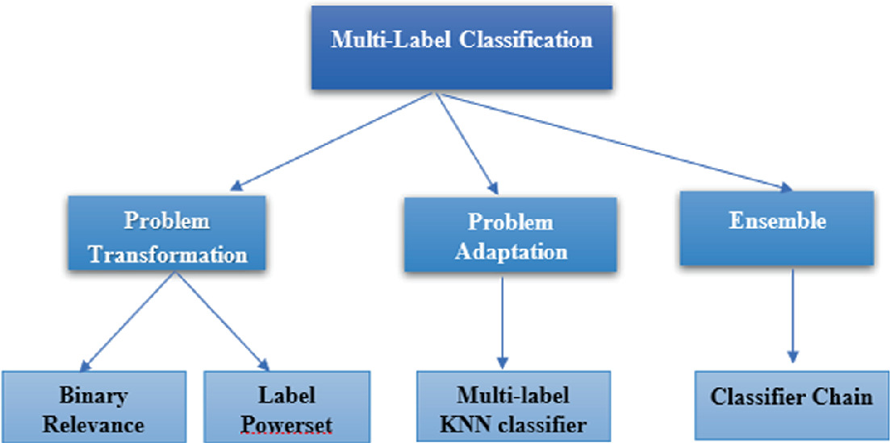
Algorithms used for Multi-Label classification

Slide 43
Evaluation metrics
Choosing the right metric is crucial while evaluating machine learning (ML) models.
Various metrics are proposed to evaluate ML models in different applications .
In some applications looking at a single metric may not give you the whole picture of the problem you are solving, and you may want to use a subset of the metrics.
There are various ways to evaluate a classification model, and we will be covering some of the most popular ones.

Slide 44
Evaluation metrics
Accuracy
Cross validation
Log Loss
Hamming Loss
F1 Score
Average precision
Auc-roc score
coverage area
label ranking average precision score=

Slide 45
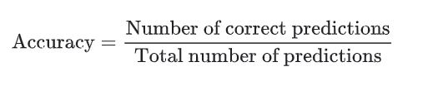
Classification accuracy
Classification accuracy is perhaps the simplest metrics one can imagine, and is defined as the number of correct predictions divided by the total number of predictions, multiplied by 100.
For an example, if out of 1100 samples 1030 are predicted correctly, the classification accuracy can be given as :
Classification accuracy= 1030/1100= 93.6%
It works well only if there are equal number of samples belonging to each class.

Slide 46
Confusion Matrix
Confusion Matrix
One of the key concept in classification performance is confusion matrix (AKA error matrix), which is a tabular visualization of the model predictions versus the ground-truth labels. Each row of confusion matrix represents the instances in a predicted class and each column represents the instances in an actual class.
Confusion Matrix is a 2X2 Matrix where:
TRUE POSITIVE: measures the proportion of actual positives that are correctly identified.
TRUE NEGATIVE: measures the proportion of actual positives that are not correctly identified.
FALSE POSITIVE: measures the proportion of actual negatives that are correctly identified.
FALSE NEGATIVE: measures the proportion of actual negatives that are not correctly identified.

Slide 47
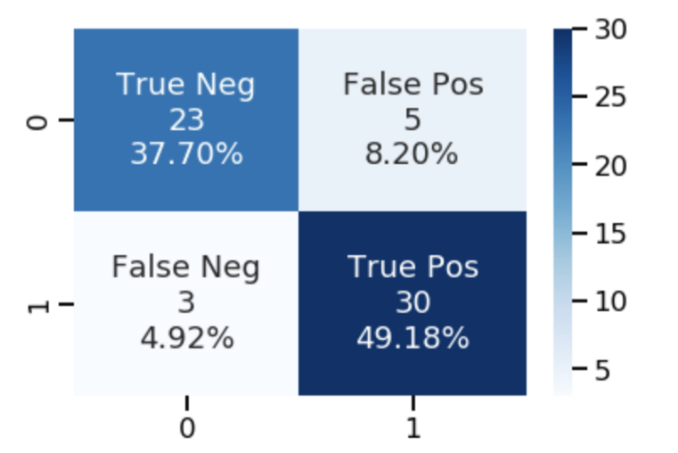
Confusion Matrix
In Multilabel confusion matrix MCM, the count of true negatives is MCM (0, 0), false negatives is MCM :,( 1, 0), true positives is MCM (1, 1) and false positives is MCM (0, 1).

Slide 48
Hamming loss Log loss
Hamming loss
It is important to note that unlikely accuracy in hamming loss the smaller the result is the better is the model. For an example if hamming loss, is 0.32 which means that if you are trying to predict the aspects of 100 sentences the model will predict incorrectly about 32% of the independent aspects.
Hamming loss value ranges from 0 to 1. Lesser value of hamming loss indicates a better classifier. It is the fraction of labels that are incorrectly predicted and brings additional information in case of unbalanced datasets.
Log loss
This is the loss function used in (multinomial) logistic regression and extensions of it such as neural networks, defined as the negative log-likelihood of a logistic model that returns y_pred probabilities for its training data y_true. The log loss is only defined for two or more labels. The bolder the probabilities, the better will be your Log Loss — closer to zero. It is a measure of uncertainty (you may call it entropy), so a low Log Loss means a low uncertainty/entropy of your model.

Slide 49
F1 score and Precision
F1 score
F1 Score might be a better measure to use if we need to seek a balance between Precision and Recall and there is an uneven class distribution (large number of Actual Negatives) as in our example.
F1-score= 2*Precision*Recall/ (Precision + Recall)
Precision
The precision is the ratio tp / (tp + fp) where tp is the number of true positives and fp the number of false positives. The precision is intuitively the ability of the classifier not to label as positive a sample that is negative.
Precision= True Positive/ (True Positive+ False Positive)

Slide 50
Coverage error and LRAP
Coverage error
Compute how far we need to go through the ranked scores to cover all true labels. The best value is equal to the average number of labels in y_true per sample.
The best value of coverage is when it is equal to average number of true class labels.
Label ranking average precision (LRAP)
It is the average over each ground truth label assigned to each sample, of the ratio of true vs. total labels with lower score.
This metric is used in Multilabel ranking problem, where the goal is to give better rank to the labels associated to each sample.
The obtained score is always strictly greater than 0 and the best value is 1.

Slide 51
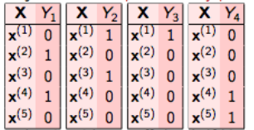
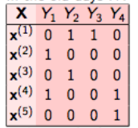
Binary relevance
Binary Relevance
This is the simplest technique, which basically treats each label as a separate single class classification problem.
Example, In binary relevance, this problem is broken into 4 different single class classification problems as shown in the figure below.

Slide 52
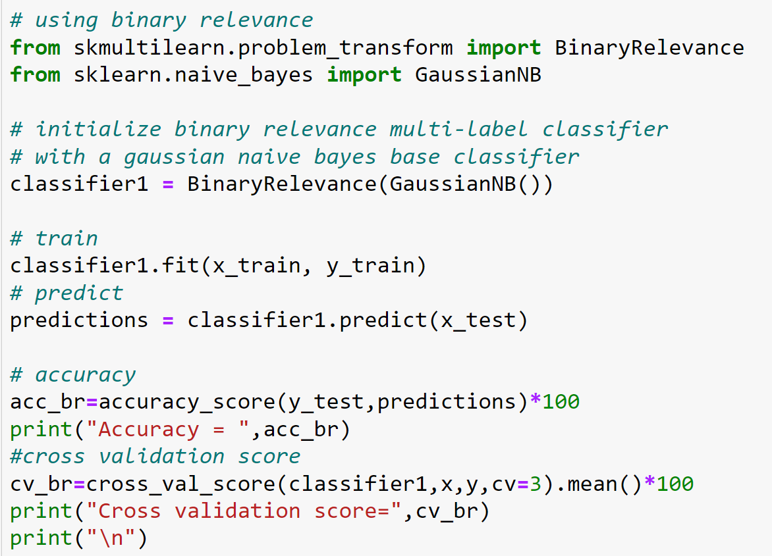
Binary relevance implementation

Slide 53
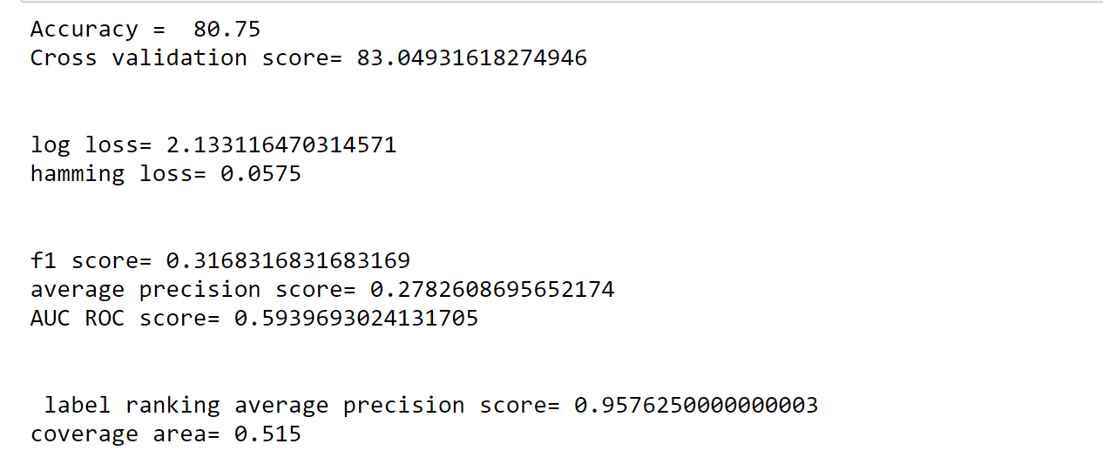
Evaluation metrics for Binary relevance

Slide 54
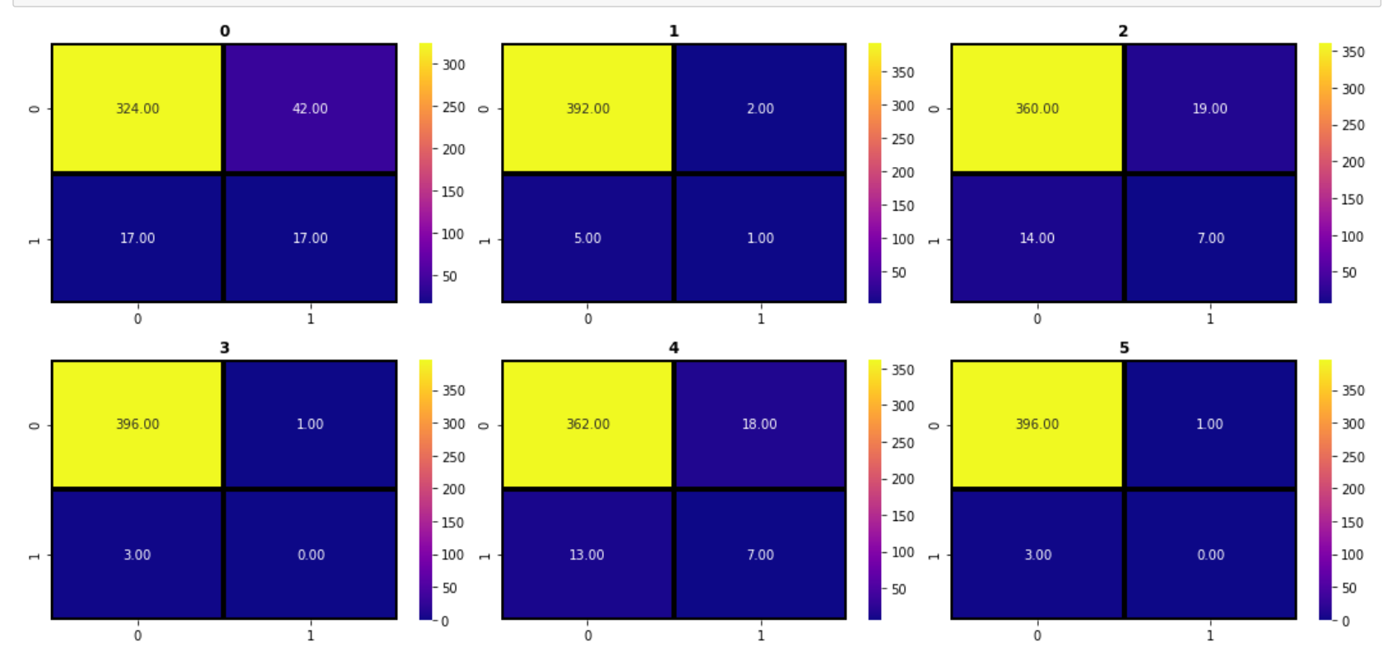
Confusion matrix for Binary relevance

Slide 55
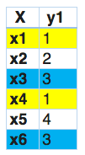
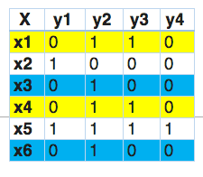
Label Power Set
In this, we transform the problem into a multi-class problem with one multi-class classifier is trained on all unique label combinations found in the training data.

Slide 56
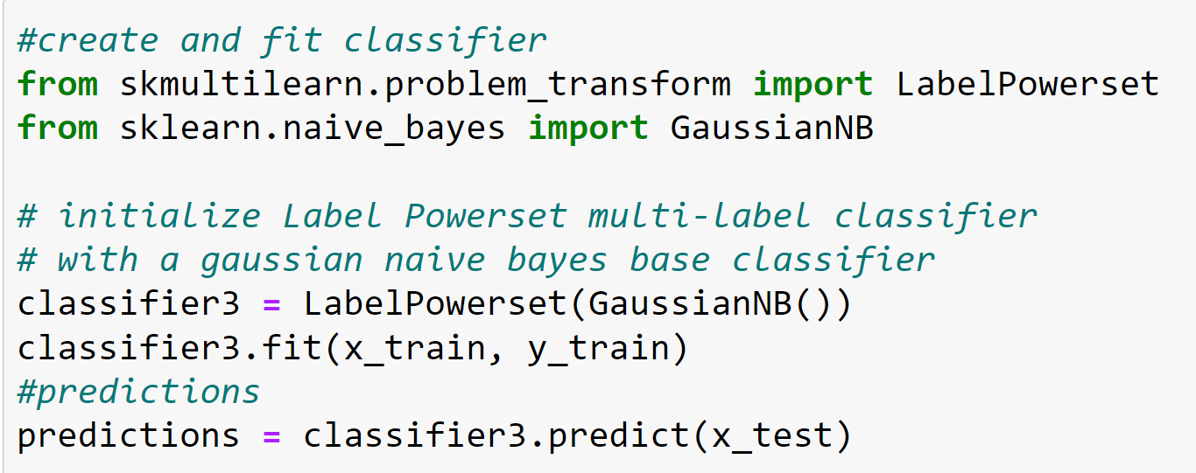
Label powerset Implementation

Slide 57
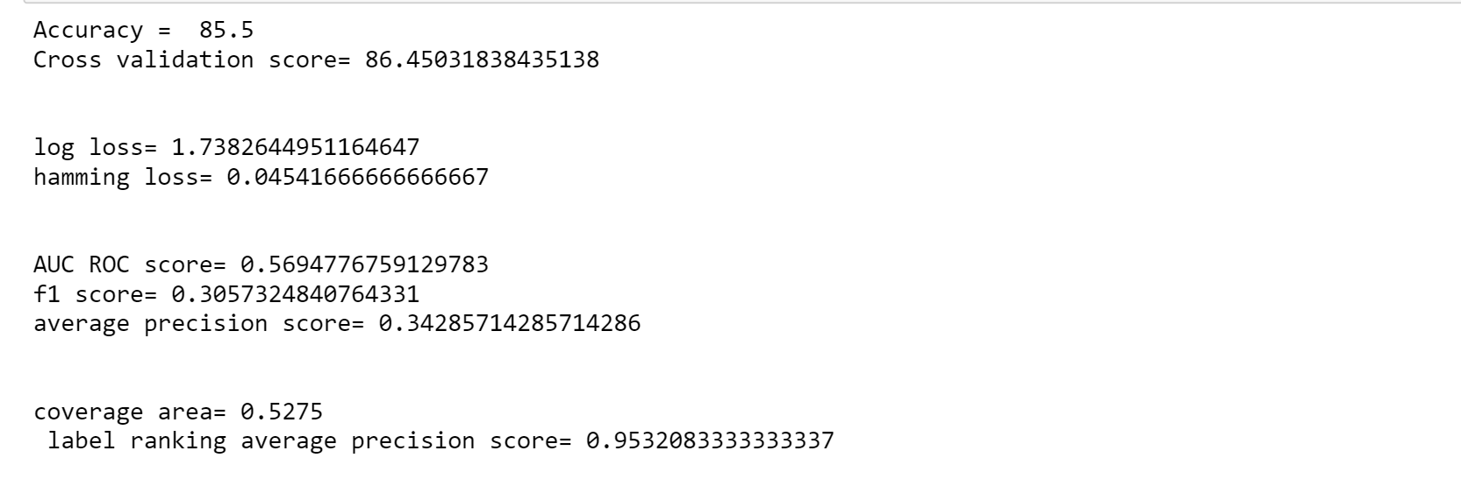
Label Power Set evaluation matrix

Slide 58
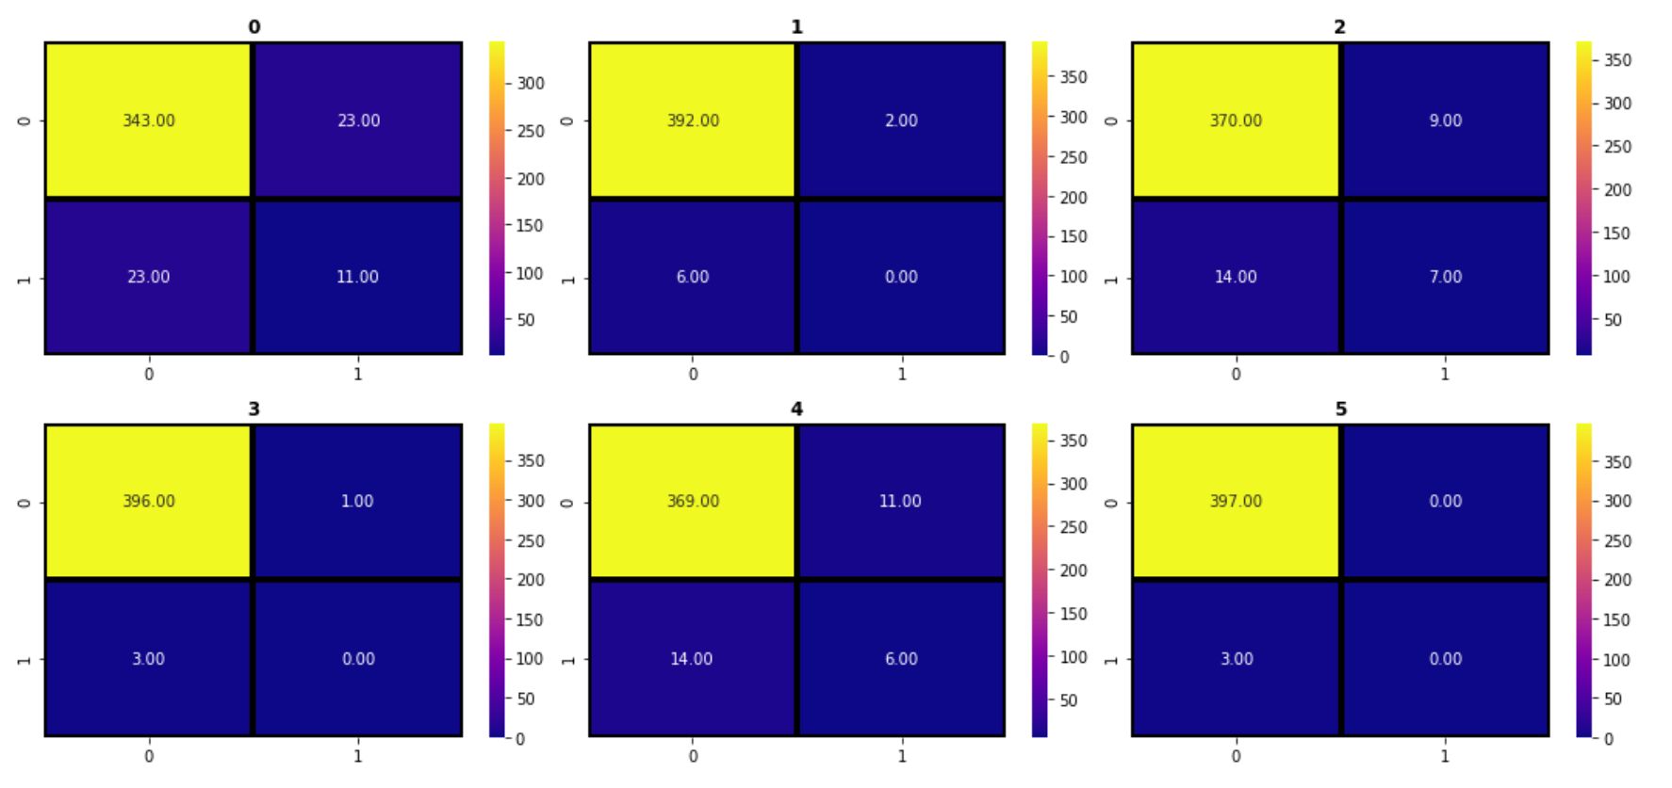
Confusion matrix for Label Power set

Slide 59
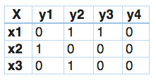
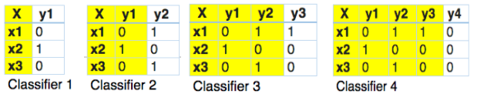
Classifier chain
In this, the first classifier is trained just on the input data and then each next classifier is trained on the input space and all the previous classifiers in the chain.

Slide 60
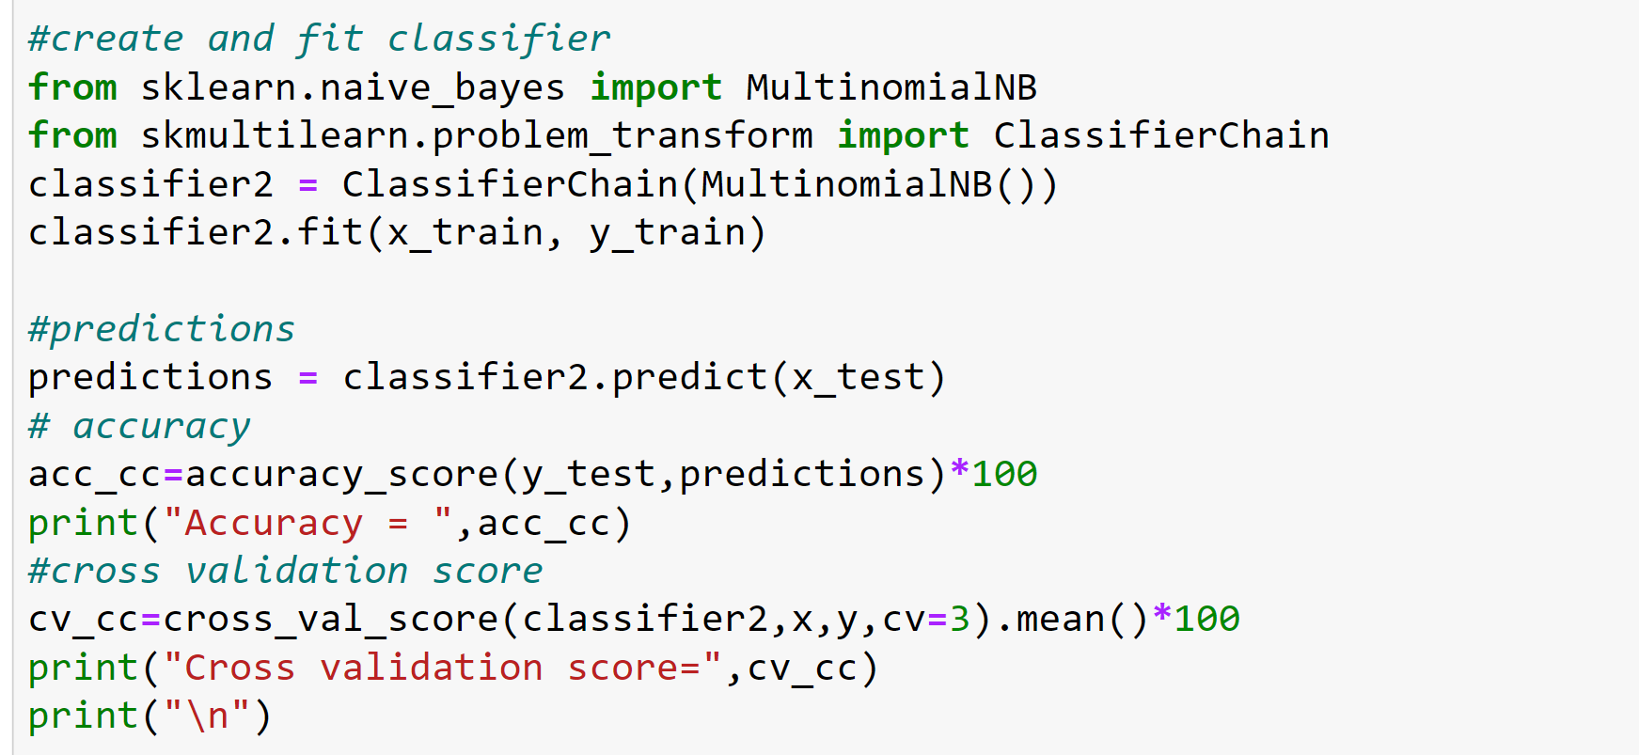
Classifier Chain implementation

Slide 61
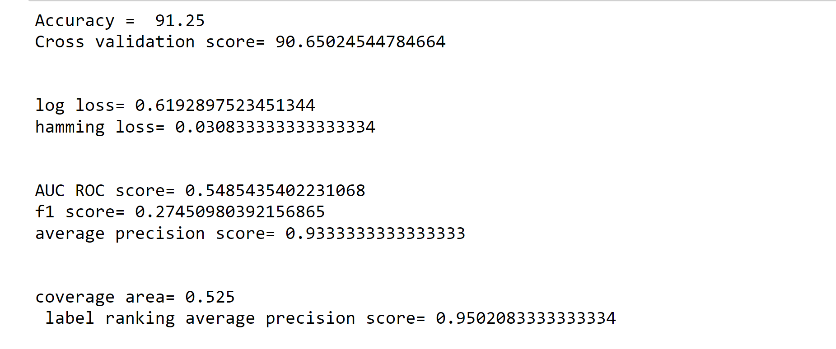
Classifier chain evaluation metrics

Slide 62
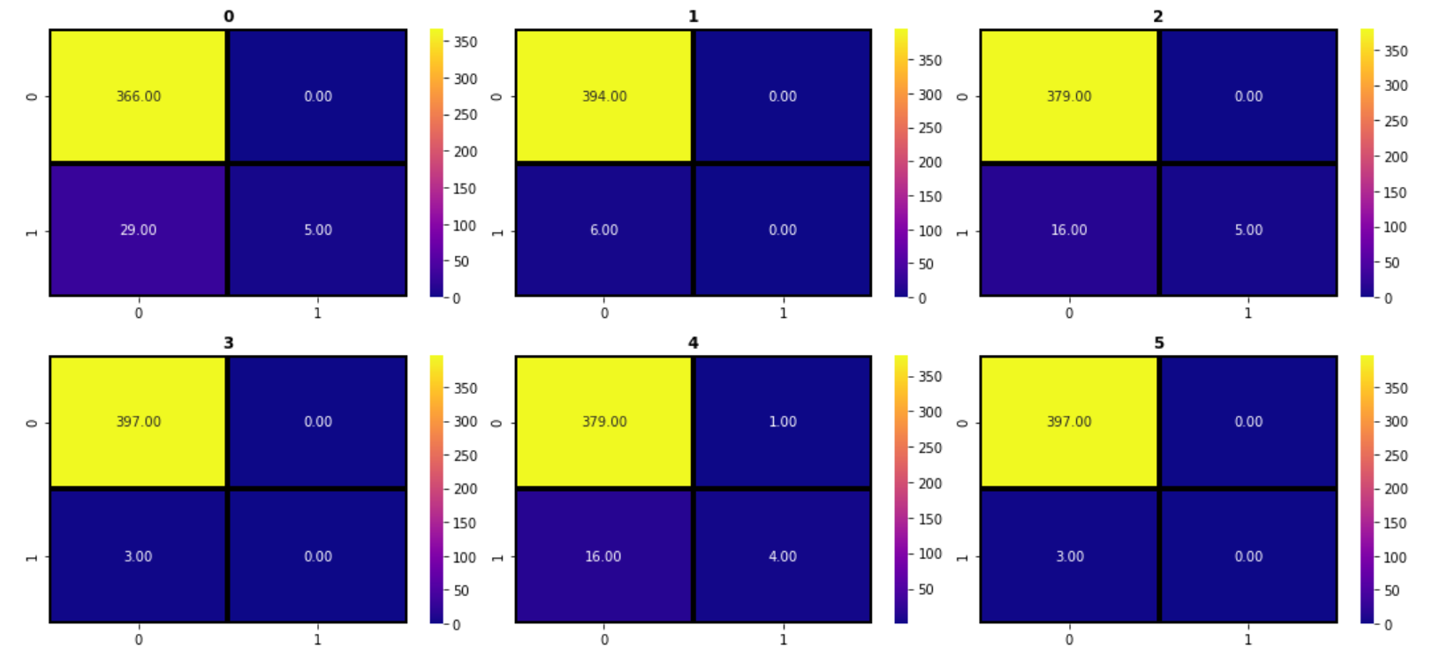
Classifier Chain Confusion matrix

Slide 63
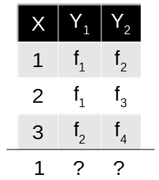

Multilabel KNN
Adapted algorithm, as the name suggests, adapting the algorithm to directly perform multi-label classification, rather than transforming the problem into different subsets of problems.
MLkNN builds uses k-Nearest Neighbors find nearest examples to a test class and uses Bayesian inference to select assigned labels. The multi-label version of kNN is represented by MLkNN

Slide 64

Multi-Label KNN

Slide 65

Multilabel KNN implementation

Slide 66

Multi Label confusion matrix

Slide 67

Finalized model
Thus after evaluation and assessment of all the implemented models we found Classifier chain model as the best one.
Classifier chain model was saved to make predictions on the test data.

Slide 68
Interpretation of the results
There were 6360 comments which fall into only 1 category of the comment type.4209 comments had 2 labels for example malignant and rude.3480 comments had 3 labels for example malignant, abuse and rude. There were 31 comments which had all 6 types of comments categories at the same time.
There were 15294 malignant comments which are maximum. Rude comments were second highest. Threat comments count was only 478 which is the least. Highly malignant and loathe comments were moderate in number.
Malignant comments had the highest share of all which was 43.6%.Rude comments were second highest and abuse had 22.4% of share in the total distribution.
Loathe comments very least (4.0%)
For the correlation; the highest co-relation was seen between rude--> abuse of 0.74.The second highest correlation is between malignant--->rude which is 0.68 malignant and abuse have a correlation of 0.65.Loathe and threat had the least correlations with all variables.

Slide 69

Interpretation of the results
We have observed all the evaluation metrics for each and every algorithm which can be concluded in the following table:
The classifier chain algorithm is saved as our final model as it is significantly working well in all the evaluation metrics. Classifier chain gave us an accuracy of 91.25 and cross validation of 90.6.log loss= 0.61 and hamming loss= 0.03.AUC ROC score= 0.54 f1 score=0.27 and average precision score= 0.93 and a good label ranking average precision score of 0.95.

Slide 70
Conclusion
Our project work has shown that harmful or toxic comments in the social media space have many negative impacts to society.
The ability to readily and accurately identify comments as toxic could provide many benefits while mitigating the harm.
The project has shown the capability of readily available algorithms to be employed in such a way to address this challenge.
There are two main methods for tackling a multi-label classification problem: problem transformation methods and algorithm adaptation methods.
Problem transformation methods transform the multi-label problem into a set of binary classification problems, which can then be handled using single-class classifiers.
Whereas algorithm adaptation methods adapt the algorithms to directly perform multi- label classification. In other words, rather than trying to convert the problem to a simpler problem, they try to address the problem in its full form.

Slide 71
Conclusion
In our specific study, it was demonstrated that classifier chain provides substantial improvement in classification versus another algorithms.
To sum up, popular methods for Multilabel classification were described and compared on real-life example. The best results were obtained for Classifier Chain method
As cyber bullying is a major societal problem. Malignant comment classifier helps to filter out toxic words to make online world a safer and more harmonious place.
The project is intended to enhance fair online talk and views sharing in social media.
We have build a prototype of online hate and abuse comment classifier which can be used to classify hate and offensive comments so that it can be controlled and restricted from spreading hatred and cyber bullying.

Slide 72
Thank you

